Slide 1
Linux
2023. 07. 17

Slide 2

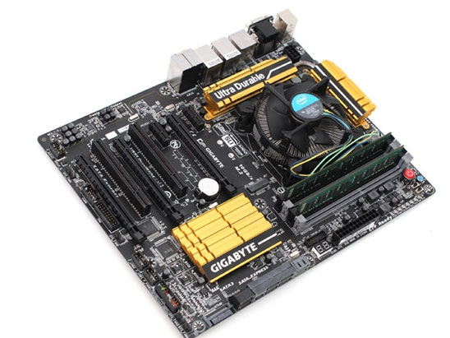
Operating System(OS)
System software that manages computer hardware and software resources.
Act as an intermediary between hardware and software.
Provide easily and efficient computing environment.
Allocate and manages computer resources efficiently for multiple users.
Be used on many devices (computer, smartphone, video game console..)
UNIX, MacOS, Windows, Linux
Software
Hardware
OS

Slide 3




Operating System(OS)
1972
1984
1985
1991

Slide 4
UNIX
UNIX is a family of multitasking, multiuser computer OS
In 1964, Multics (Multiplex Information and Computing System) was developed for the GE-645 mainframe, But it had many problems.
In 1969, a computer system called PDP-7 was used to develop operating system called Unics (Uniplexed Information and Computing System) by Ken Tompson, Dennis Ritchie, and others.
Since then, Dennis Ritchie has developed a high-level language “C”
In 1972, Unix was rewritten in the C language using PDP-11.
Since then, many organizations have developed Unix distributions, including BSD (Berkeley), Solaris (Sun Microsystems), and MacOS (Apple)
AT&T finally sold its rights in Unix to Novell in the early 1990s

Slide 5
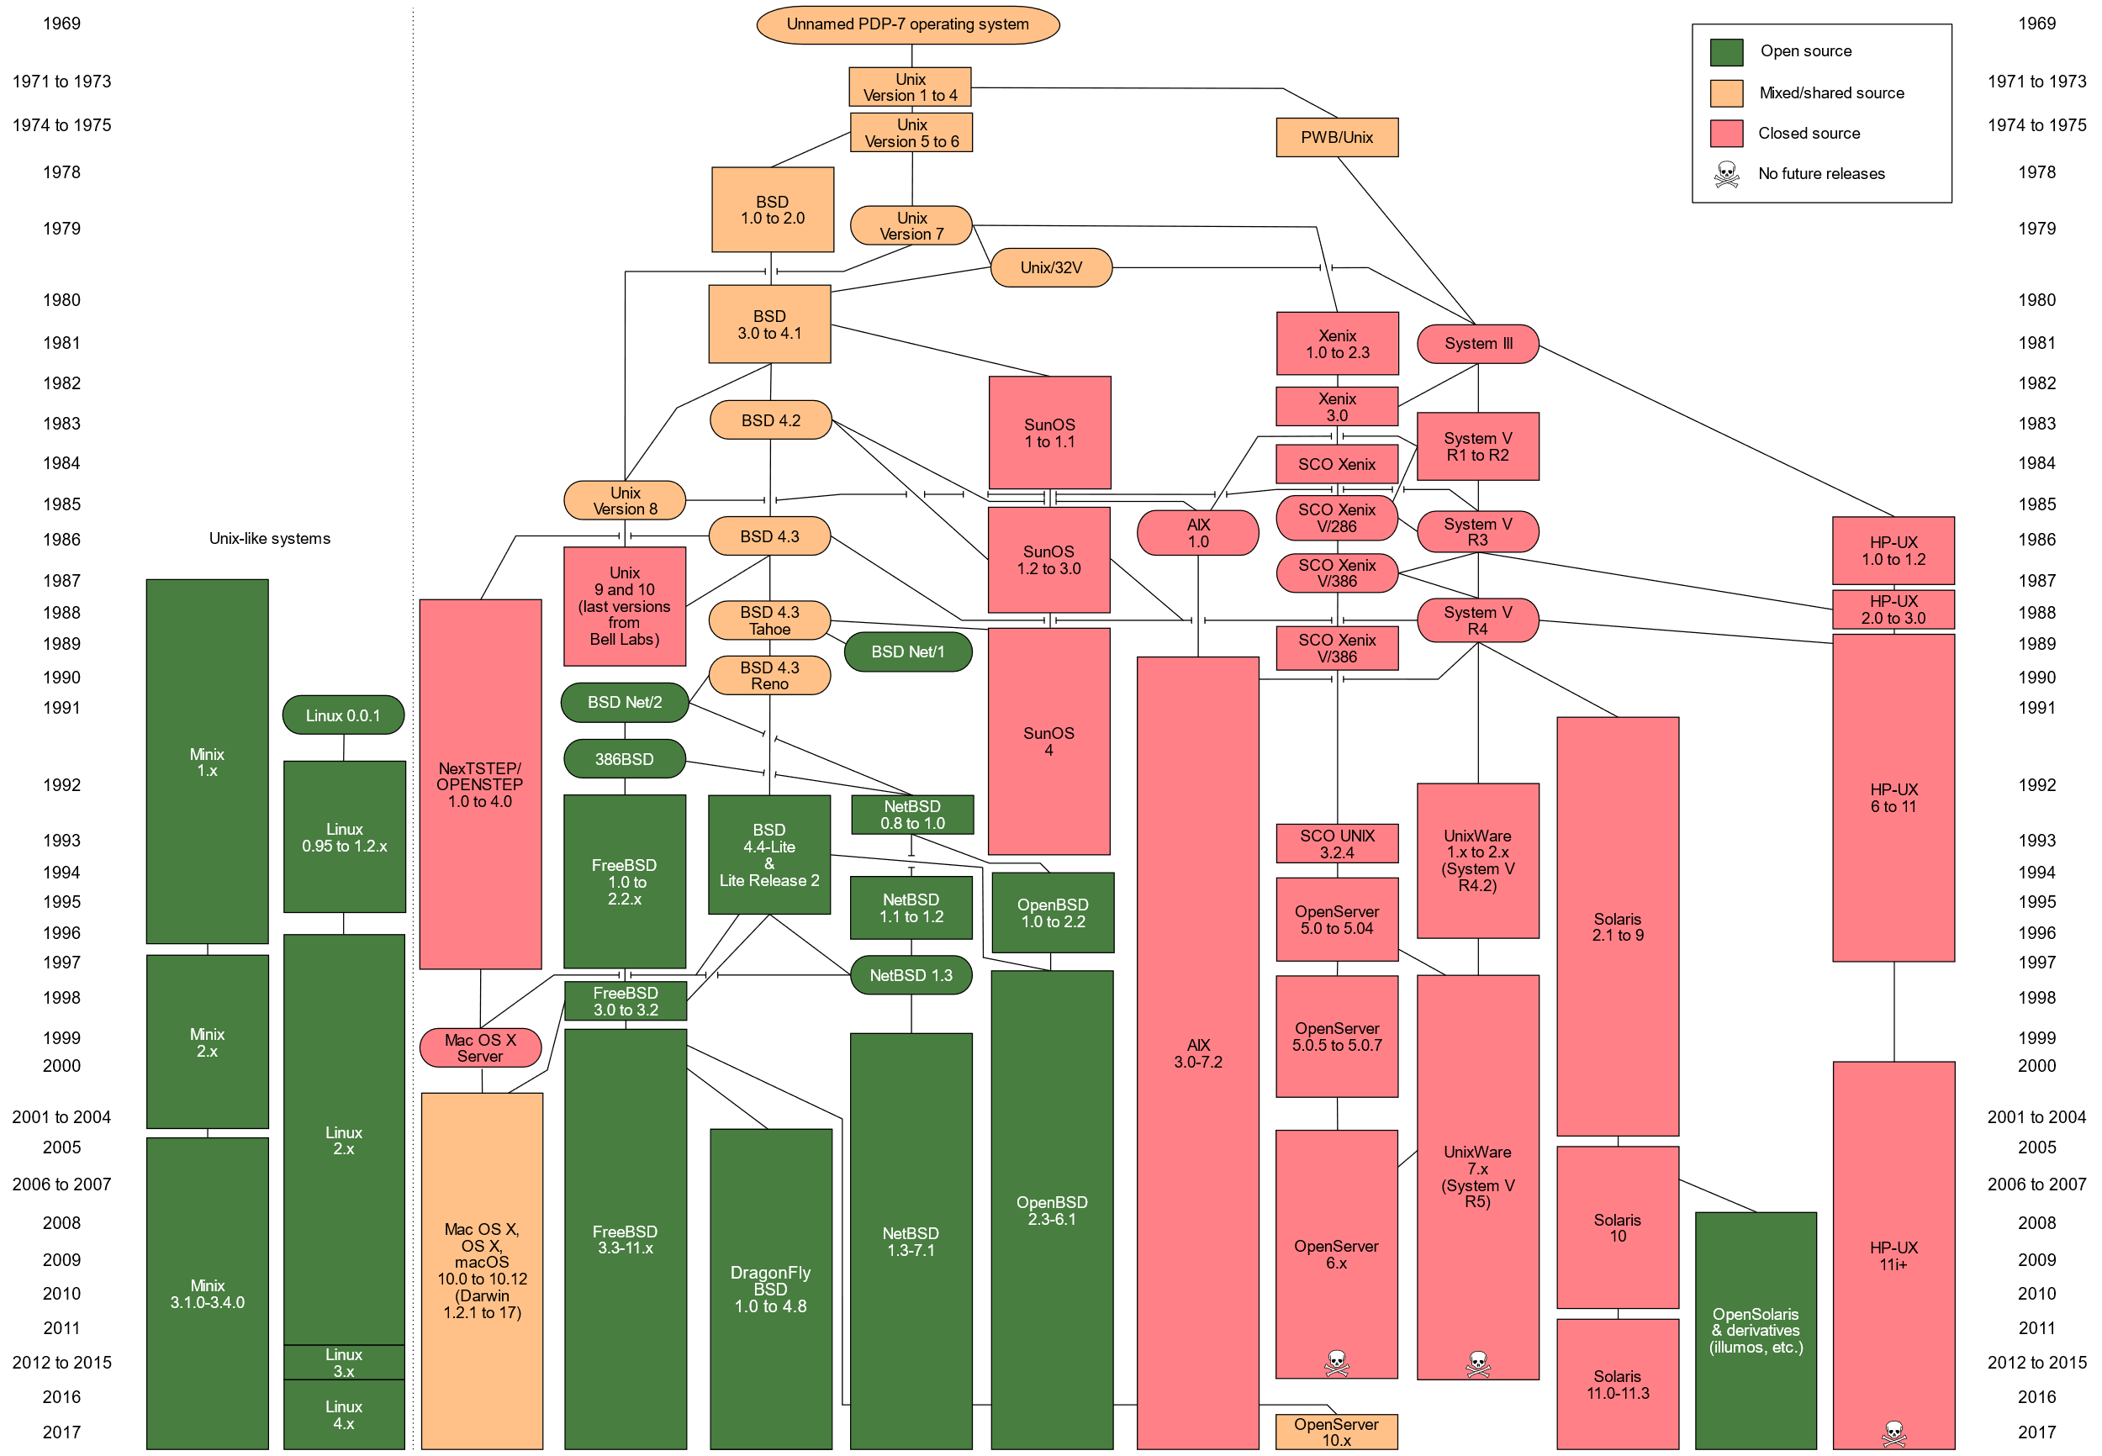
UNIX
https://ko.wikipedia.org/wiki/%EC%9C%A0%EB%8B%89%EC%8A%A4#/media/File:Unix_history-simple.svg

Slide 6


Linux
Linus Torvalds, a student at the University of Helsinki, was frustrated by the license of MINIX, which was used only for educational purposes.
In 1991, Torvalds began to build his own operating system kernel which is also possible to use applications written for MINIX.
GNU components have integrated with the Linux kernel = GNU/Linux
Linux Torvalds
Tux

Slide 7
Market share in OS
Share(%)

Slide 8
Why!!
should we learn Linux??

Slide 9

Must be stable system
Must be suitable for big data analysis

Slide 10
OS in top 500 computers
97.8%
100%
2015
2023
https://www.top500.org/statistics/list/

Slide 11


GNU (GNU is not UNIX) Project
GNU is a free-software project, first announced in 1983 by Richard Stallman
Primary objective is to give computer users the freedom to control their computers and computing devices.
Users are free to run, share (copy, distribute), study, and modify software.
In 1985, Stallman founded FSF (Free Software Foundation) to support free software development.
In 1989, GPL (GNU Public License) was announced to guarantee computer program rights.
Richard Stallman
GNU logo

Slide 12
General Public License(GPL)
Free software license created by GNU project
GPL is most widely used copyleft license
Guarantees users the freedom to run, study, share, and modify the software
Copyright: based on restrictions / Copyleft: based on sharing
Five obligations related to software
Use the computer program for any purpose. However, there is no restriction on the law.
Must sell an executable copy of a computer program with the it's source code or distribute at free.
The source code of the computer program can be changed according to the purpose.
The modified computer program must distribute the source code of itself publicly.
The modified computer program must also have the same license. In other words, the GPL license must be applied.

Slide 13
Linux
Linux is a Unix-like computer operating system
Released in 1991 by Linus Torvalds
Actually operating system kernel
Linux system is actually GNU/Linux systems
Linux = Free UNIX
Text Editor
Web browser
Web server
X-window
DB
Application Program
Shell
Kernel
Bourne-Again shell
Bourne shell
Korn shell
Hardware
CPU, RAM, HDD

Slide 14
Kernel & Shell
Kernel
Core of operating system
Complete control over everything in the system.
Secure, Memory, Device, and Process Management
Shell
Layer wrapping the interface between the user and the kernel.
Read and interpret user’s command
Command Line Interface(CLI), Graphical User Interface(GUI)
User
Shell
CPU
Memory
Kernel
Devices

Slide 15






Linux Distributions
Linux distribution is an operating system made from a software collection.
Linux kernel, GNU tools and libraries, additional software, documentation, a window system, a window manager, and a desktop environment.
Linux has several distributions.
Red hat, Debian, Slackware
https://upload.wikimedia.org/wikipedia/commons/1/1b/Linux_Distribution_Timeline.svg

Slide 16
Red Hat Enterprise Linux VS CentOS
Red Hat Enterprise Linux (RHEL) is one of the most popular Linux distributions developed by Red Hat.
Although RHEL is commercially available, most of the source code is released (except for Red Hat's own programs and drivers) because the license is under the GNU GPL.
CentOS is also a Linux distribution made to provide a free computing platform functionally compatible with RHEL.
CentOS was created by importing and rebuilding the RHEL source code.

Slide 17
Red Hat Enterprise Linux VS CentOS
Red Hat Enterprise |  | CentOS |  | Kernel version
release date | RHEL version | release date | CentOS version
2002.05 | 2.1 | 2002.05 | 2.1 | Kernel 2.4.9
2003.08 | 3.1 | 2004.03 | 3.1 | Kernel 2.4.21
2005.02 | 4.0 | 2005.03 | 4.0 | Kernel 2.6.9
2007.03 | 5.0 | 2007.04 | 5.0 | Kernel 2.6.18
2010.11 | 6.0 | 2011.07 | 6.0 | Kernel 2.6.32
2014.06 | 7.0 | 2014.07 | 7.0 | Kernel 3.10.0
2019.05 | 8.0 | 2019.05 | 8.0 | Kernel 4.18.0

Slide 18
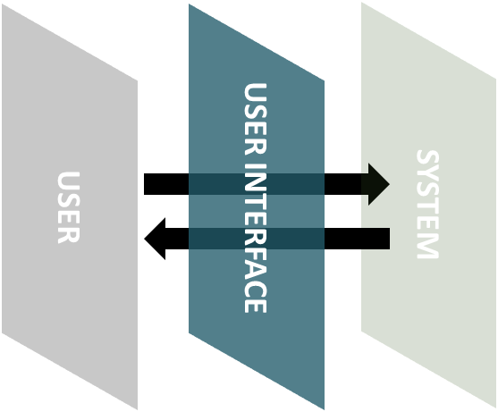
User Interface
A physical or virtual mediator to communicate between user and computer systems.
Command execution environment to use the shell programs.
USER
USER INTERFACE
SYSTEM

Slide 19
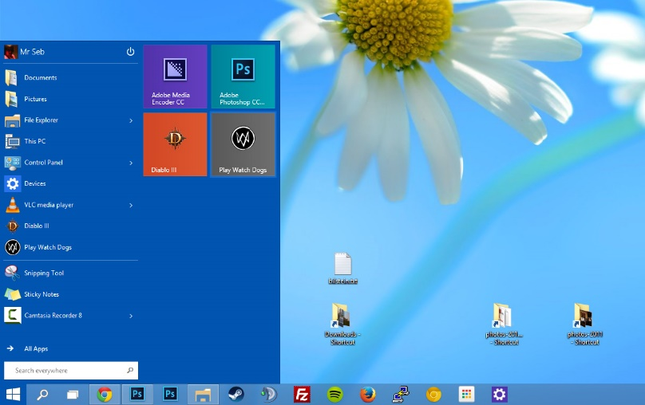
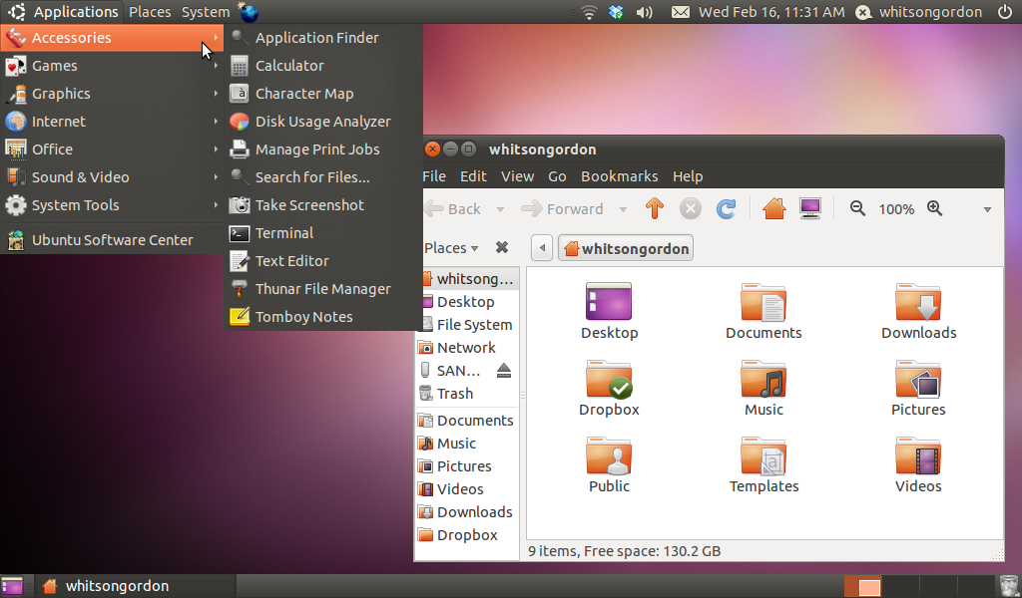
Graphical user interface(GUI)
The graphical user interface is a type of user interface that allows users to interact with electronic devices through graphical icons and visual indicators
Windows 10's GUI
Linux GNOME

Slide 20
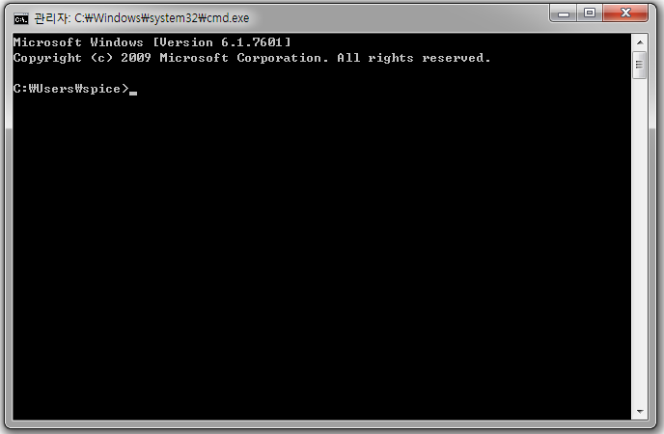
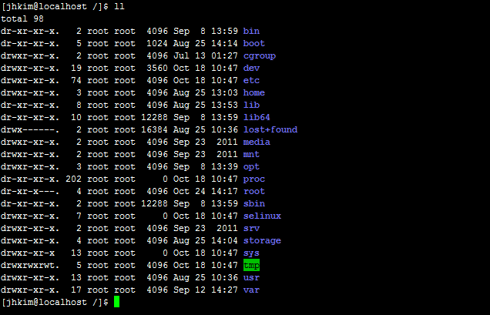
Command line interface(CLI)
The command-line interface (CLI), or command interface, is a way of interacting between computer and user through a command prompt
CMD.exe
Linux bash Shell

Slide 21
Why !!
should we use CLI instead of GUI?

Slide 22
User Interface
CLI uses fewer computer resources than GUI.
GUI is more difficult to execute sequentially than CLI.
ex) mkdir one; cd one; mkdir two; cd two
CLI is easy to run many programs at once.
Most bioinformatics programs don’t provide a GUI environment.
Unfortunately, you need to know how to use the CLI to do bioinformatics analysis.

Slide 23
Bioinformatic analysis tools
도구 | 설명 | 참고문헌
BEDTools | 대용량 유전체의 위치정보 분석 도구 | Quinlan and Hall, 2010, Bioinformatics
BLAST | 서열 유사성을 기반 DNA, 단백질 서열 분석 도구 | Altschul et al., 1990, Journal of Molecular Biology, 215(3), 403-410
BLAT | 유전체 서열과 쿼리 서열 사이의 정렬 도구 | Kent, 2002, Genome Research, 12(4), 656-664
Bowtie | 유전체 서열 정렬 분석 도구 | Langmead et al., 2009, Genome Biology, 10(3), R25
BWA | 유전체 서열 정렬 분석 도구 | Li and Durbin, 2009, Bioinformatics, 25(14), 1754-1760
ClustalW | 다중 서열 정렬을 수행하는 도구 | Thompson et al., 1994, Nucleic Acids Research, 22(22), 4673-4680
EMBOSS | 생물 정보학 연구를 위한 커맨드 라인 도구 모음 | Rice et al., 2000, Trends in Genetics, 16(6), 276-277
GAPIT | 전장유전체 연관분석 도구 | Lipka et al., 2012, Bioinformatics, 28(18), 2397-2399
GATK | 유전체 변이 탐지 및 분석 도구 | McKenna et al., 2010, Genome Research, 20(9), 1297-1303
HISAT | 유전체 및 전사체 염기서열 정렬 도구 | Kim et al., 2015, Nature Methods, 12(4), 357-360
HMMER | 은닉 마코프 모델 기반의 모티프 분석 도구 | Eddy, 1998, Bioinformatics, 14(9), 755-763
HTSlib | 대용량 유전체 정보(BAM 및 VCF) 처리 도구 | JK, 2021, Gigascience, 10(2), giab007
MUSCLE | 다중 서열 정렬을 수행하는 도구 | Edgar, 2004, Nucleic Acids Research, 32(5), 1792-1797
plink | 전장유전체 연관분석 도구 | Purcell et al., 2007, American Journal of Human Genetics, 81(3), 559-575
Primer3 | PCR 프라이머 디자인 도구 | Untergasser et al., 2012, Bioinformatics, 40(15), e115
SAMtools | Sequence Alignment/Map (SAM) / Binary SAM (BAM) 파일 기반 유전체 분석 도구 | Li et al., 2009, Bioinformatics, 25(16), 2078-2079

Slide 24
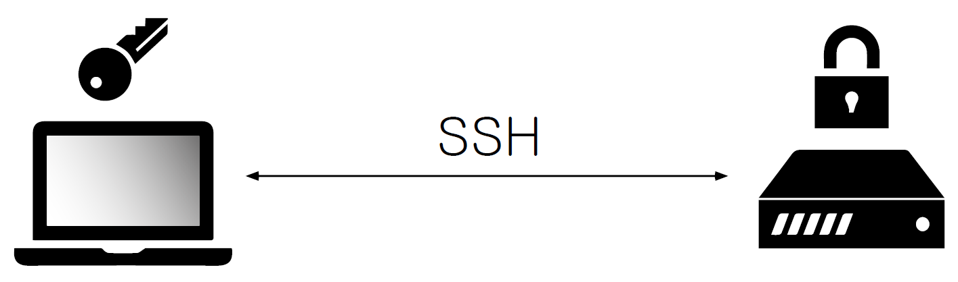
Secure shell (SSH)
An application or protocol that allows you to log in to another computer on the network, run commands on the remote system, and copy files to another system.
SSH provides a robust authentication method, ensuring a secure network connection.
Typically, SSH operates on port number 22.
SSH Client
SSH Server

Slide 25
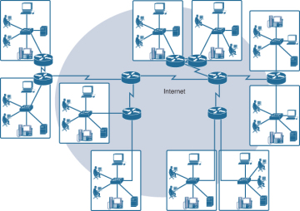
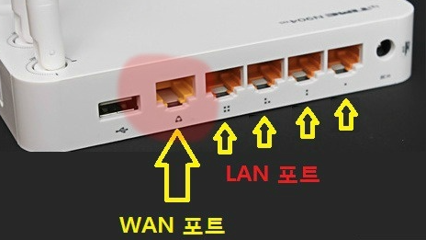
Network
Network is the interconnection between devices capable of communication.
LAN (Local Area Network): interconnects computers within a limited area such as a residence, school, laboratory, university campus, or office
WAN (Wide Area Network): extends over a large geographical distance.
Internetwork (internet): more different networks connected by routers, bridges, etc.
Internet (uppercase I): the global system of interconnected computer networks.

Slide 26


Internet
To communicate between different computers, Internet protocols are required.
IP (Internet Protocol) is a unique address allowing the computer to communicate with others.
IPv4 - consists of 4 decimal digits separated by dots (.), with each number having a value between 0 and 255. ex) 142.251.214.142
Port is a number that identifies a program on a particular computer in the network. ex) 80
Domain names are human-readable strings that represent the computer addresses on the network ex) google.com
210.48.158.22
142.251.214.142:80
142.251.214.142 : google.com
Request
Response
User
google.com
Client
Server
Notes:
다음으로 인터넷에 대해서 알아보도록 하겠습니다. 저희가 다른 컴퓨터와 정보를 통신을 하기 위해서는 인터넷이 필요합니다. 이렇게 원거리에 있는 컴퓨터 끼리 통신하기 위해서는 그 컴퓨터를 인식 할 수 있는 id같은 것이 필요한데요. 그러한 id가 ip주소입니다, ip는 internet protocol을 줄임말이구요 네트워크에 연결되어 있는 컴퓨터는 각 각 교유한 ip주소를 가지고 있습니다. 그래서 원거리에 있는 컴퓨터 끼리 서로를 인식 할 수 있는 것입니다. 이러한 ip주소는 10진수 0~255의 숫자 4개를 .으로 구분하여 사용합니다. 이해를 돕기 위해서 사용자가 구글에 접속 하는 것을 예로 들어보겠습니다. 저희가 구글에 접속하기 위해서는 웹브라우저 주소창에 www.google.com이라고 입력하고 컴퓨터에 접근합니다.이러한 주소를 domain name이라고 하고 사람이 인식 할 수 있게 만들어 놓은 주소라고 보시면 됩니다, 이와 다르게 domain name대신에 ip주소를 적어도 구글에 접속할 수 있습니다. 저희가 주소창에 구글 주고를 넣으면 이 주소는 ip주소로 바뀌고 이 ip 주소를 통해서 컴퓨터에 접근하는 것이지요.
여러분의 컴퓨터를 보시면 여러 개의 프로그램이 설치 되어있습니다, 만약 제가 여러분의 컴퓨터와 네트워크 통신을 해서 office라는 프로그램을 사용한다고 가정 해보겠습니다. 각각의 컴퓨터는 ip주소를 가지고 있기 때문에 제가 여러분의 ip주소를 가리켜서 컴퓨터에 접속합니다. 이때 컴퓨터는 인식했지만 프로그램이 무엇이 있는지 어떤것인지 인식을 할 수 없습니다. 그래서 필요한것이 port number입니다. port번호는 사용자의 컴퓨터에서 프로그램을 인식하는 주소로 보시면 될것같습니다, 저희가 구글에 접속할 때 ip주소만 입력하지만 원래는80이라는 것을 붙여줘야 합니다. 웹 프로그램을 인식하는 포트번호가 80이기 때문입니다. 하지만 이것은 워낙 당연시 되기 때문에 따로 80이라고 명시 하지 않는 것입니다. 다음으로 클라이언트 서버 개념입니다. 이건 단순히 네트워크 상에서 데이터를 요청하는 부분이 클라이언트 데이터를 제공해주는 컴퓨터를 서버라고 부릅니다. 저희가 보통 서버라고 하면 엄청 좋은 컴퓨터를 생각하게 되는 이유를 많은 클라이언트의 요청을 처리 해야 하기 때문에 서버컴퓨터가 좋은 컴퓨터 일 수 밖에 없습니다.

Slide 27
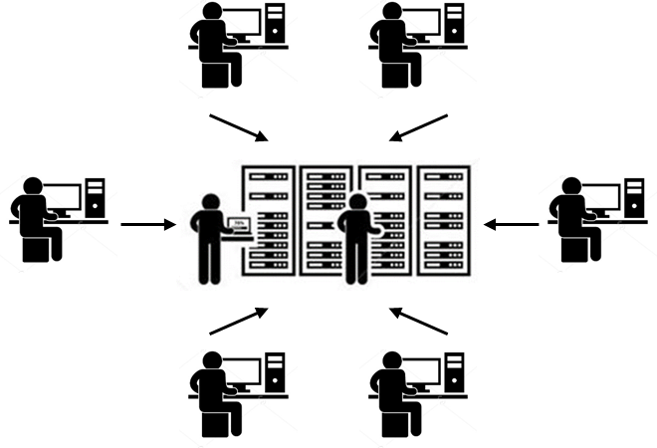
Multi-User
Linux is an operating system that supports multi-user and multi-tasking environments.
Multi-User means that many people can access the same computer at the same time.
For multi-user concepts, it is necessary to distinguish who is accessing the system.
Linux ensures that users are granted individual permissions, allowing them to have separate accounts, access privileges, and personalized settings.

Slide 28
Superuser vs User
There are two types of users in Linux. “Superuser vs User”
Superuser
Special user that has tremendous power, with the ability to access and modify all files on the operating system.
This is necessary at times, but there is a potential for accidental errors to cause a great deal of destruction, so you have to be careful
Uses the "/root" directory as home directory.
User
Common users that have ability to access and modify only own files.
Only working in own home directory.
Uses the “/home/user(own id)” directory as home directory.

Slide 29
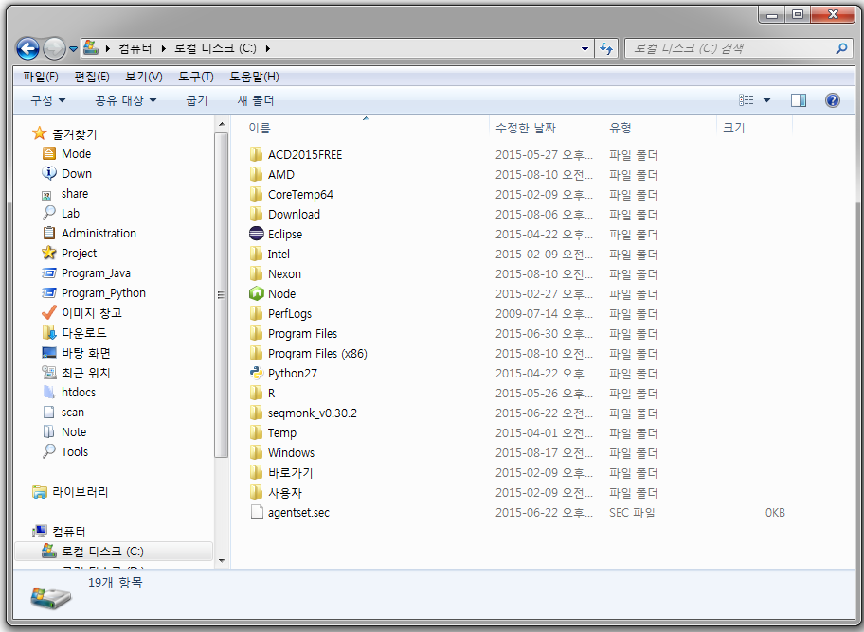
File System of Windows
Windows
C:
D:
Program Files
Windows
usr
Down
Data
Windows Defender

Slide 30
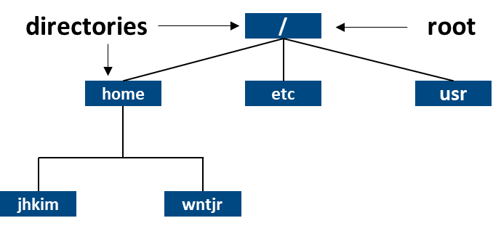
File System of Linux
Filesystem Hierarchy Standard (FHS) defines the directory structure and directory contents in Linux distributions.
Most Linux distributions develop in compliance with the FHS.
All files and directories appear under the root directory( / ), even if they are stored on different physical or virtual devices.

Slide 31
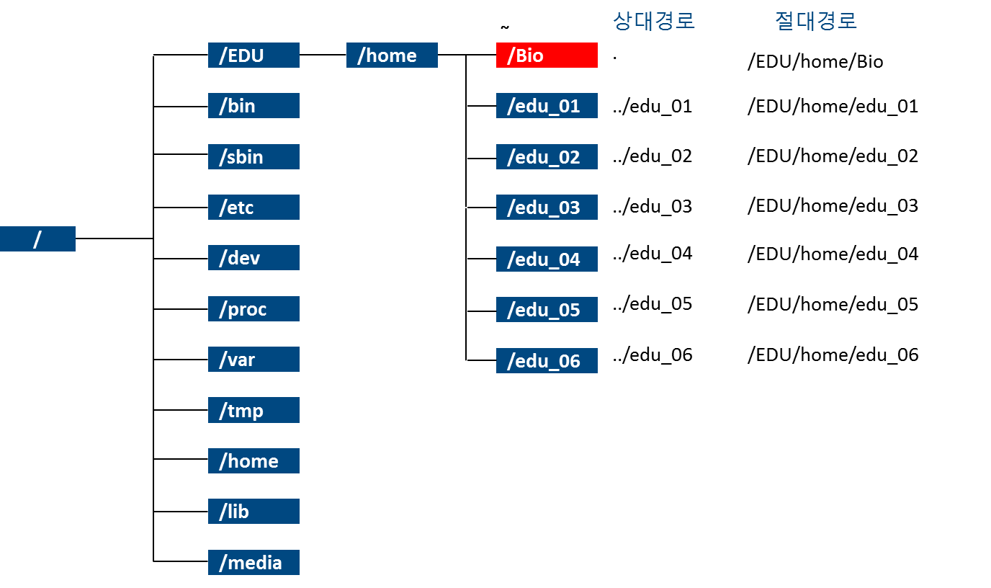
Directory Path
Characters | Description
/ | Directory separator
. | Current directory indicator
.. | Parent directory indicator
~ | User home directory indicator
Absolute path
Absolute path is defined as specifying the location of a file or directory from the root directory(/)
Relative path
Relative path is defined as a path related to the present working directory
Notes:
현재 우리 서버의 디렉터리 경로를 나타낸 것입니다. 저희가 사용할 디렉터리는 Bio라는 디렉터리입니다. 이것은 루트를 기준으로 에듀 , home 디렉터리 안에 있습니다. 다음으로 스페셜 캐릭터에 대해서 알아보겠습니다. 슬래쉬는 디렉터리의 구분자 입니다. 그리고 .은 현재 사용자가 위치하고 있는 디렉터리를 나타내는것이며 ..은 그 위에 있는 디렉터리를 나타낸 것입니다. 다음으로 절대경로 상대경로에 대해서 알아 보겠습니다. 절대 경로는 현재 작업 디렉터리와 관계없이 디렉터리의 절대적인 위치를 나타내는 경로이고 상대경로는 현재 작업 디렉터리를 기준으로 상재덕인 위치를 나타내는 경로 입니다. 이것이 무슨 말이냐 하면 그림을 보겠습니다. 만약 저희가 bio라는 디렉터리에 위치해있다고 가정 하겠습니다. 그 상태에서 edu_01이라는 디렉터리의 위치를 알고 싶다고 했을때를 생각 해보겠습니다. 아까 점은 현재 디렉터리 ..은 상위 디레터리라고 했습니다. 그래서 ..을 하면 상위인 홈 디렉터리로 갑니다. 그리고 그 아래의 edu_01을 나타내는 bio 디렉터리에서 edu_01 디렉터리의 상대적인 위치를 알수 있는것입니다. 이때 디렉터리를 구분 하기 위해서 /를 사용해서 디렉터리를 구분해 줍니다. 다음 으로 절대 경로는 루트는 기준으로 경로를 나타낸 것입니다. 현재 내가 작업하고 있는 위치가 어디든지 간에 edu_01의 위치는 루트에서 에듀에서 홈에서 에듀_01로 나타내게 됩니다.

Slide 32
Linux Command
ls -l /home
Command name
Options
Arguments
Notes:
다음으로 명령어 입니다. 리눅스의 명령어는 크게 명령어 이름, 옵션, 명령인자로 이루어 집니다. 이것을 숙지하시고 지금부터 명령어에 대해서 배워보도록 하겠습니다.

Slide 33

Special Characters
ls -l /home
Special Character
Characters | Description
/ | Directory separator
. | Current directory indicator
.. | Parent directory indicator
~ | User home directory indicator
>, < | Redirection
| | Pipe

Slide 34
Basic Command
pwd : “pwd” command gives us the absolute path of current directory.
ls : “ls” command is used to know what files are in your directory.
Option | Description
-a | show all files including hidden files.
-l | show detail information of files.
-k | show file size in kilobyte.
-h | show file with human-readable file size.
-R | list subdirectories recursively
ll = ls –l (alias)

Slide 35
Basic Command – changing directory
cd
cd [directory name] : move specified directory.
cd [..] : move parent directory.
cd : move user home directory.
cd ~ :
cd - :
Characters | Description
/ | Directory separator
. | Current directory indicator
.. | Parent directory indicator
~ | User home directory indicator

Slide 36
Basic Command – file operations
touch : create empty files or update the timestamps of existing files.
cp : copy files. it takes two arguments.
cp [source] [destination]
cp [source.txt] [destination.txt] : copy source.txt to destination.txt
mv : move files and rename files.
mv [source.txt] [destination.txt] : rename source.txt to destination.txt
mv [source.txt] [destination/source.txt] : move source.txt to destination directory.

Slide 37
Basic Command – directory operations
mkdir : create the directory. if specified directory does not already exist.
rmdir : remove the directory. if directory contents are empty.
rm : remove directories or files.
Option | Description
-I | prompt before every removal
-f | Ignore nonexistent files, and never prompt before removing.
-r, -R | Remove directories and their contents recursively.
-v | Verbose mode; explain at all times what is being done.
Caution: rm –rf *
By default, rm does not remove directories. If the -r (--recursive) option is specified, however, rm will remove any matching directories and their contents.

Slide 38
Basic Command – viewing files
cat : print all the contents of files to the screen.
less : print the contents of the files on a new screen.
more : If the contents of the file does not exceed one page, it is the same as cat. More than that, it works the same as less.
head : print the first 10 lines of file to standard output.
tail : print the last 10 lines of file to standard output.
head & tail common option
Option | Description
-n | output the number of specified lines.
-c | output the number of specified bytes.

Slide 39
Autocompletion
Autocompletion is a powerful feature in software applications that automatically suggests or completes a partially typed command or word.
When you start typing a command or a file/directory name and press the “Tab” key, the system attempts to complete it based on the available options.
For example, if you have a directory with three files (file1.txt, file2.txt, file3.txt), and you type ls fi and then press “Tab”, the shell will automatically complete the command as far as it can based on the files present (ls file), and pressing “Tab” again will cycle through the file options (file1.txt, file2.txt, file3.txt).
#There are three files in the current directory
(base) [wntjr3364@localhost test]$ ll
total 0
-rw-rw-r--. 1 wntjr3364 wntjr3364 0 Jul 5 10:54 file1.txt
-rw-rw-r--. 1 wntjr3364 wntjr3364 0 Jul 5 10:54 file2.txt
-rw-rw-r--. 1 wntjr3364 wntjr3364 0 Jul 5 10:54 file3.txt
(base) [wntjr3364@localhost test]$ ls fi
(base) [wntjr3364@localhost test]$ ls file
(base) [wntjr3364@localhost test]$ ls file
file1.txt file2.txt file3.txt
Tab
Tab

Slide 40
Wildcards
Wildcards are commonly used in shell commands in Linux and other Unix-like operating systems.
Symbol used to replace or represent one or more characters in a command.
The shell interprets these wildcards, and the results are then returned to the command.
Option | Description
* | match any number of any characters including none
? | match any single character
[abc] | match one character given in the bracket
[!abc] | match one character that is not given in the bracket
[a-z] | match one character from the range given in the bracket
[!a-z] | match one character that is not from the range given in the bracket

Slide 41

Standard I/O (input/output)
#0 stdin
Standard Input
Process
#1 stdout
Standard Output
#2 stderr
Standard Error
File descriptor: Standard input, output, and error are also represented numerically in shell or system programming.
Type | Device | File descriptor
Standard Input | Keyboard | 0
Standard Output | Monitor | 1
Standard Error | Monitor | 2

Slide 42
I/O (input/output) redirection
Input redirection
By default, stdin input from the keyboard, but redirection allows input from the file.
[command] < [file] : The contents of the file become the input value of the command.
Output redirection
By default, stdout and stderr are printed on your screen, but we can redirect that output to a file.
[command] > [file] : Save the execution results of the command to a file.
[command] >> [file] : Append the execution results of the command to a file.

Slide 43
PIPE
Pipe “|”
Pipe is used to redirect a stream from one program to another.
To make a pipe, put a vertical bar (|) on the command line between two commands.
When use pipe between the first program and the second program, the first program’s data is transferred to input of the second program through pipe.
Two or more commands connected in this way form a pipe.
ll | less
less text | grep “string” | wc –l
program 2> program.err | gzip 1> result.gz 2> result.gz.err

Slide 44
;, &&, ||
Semicolon(;)
command A ; command B
Execute the “command B” regardless of whether “command A” is failed or not.
Double ampersand(&&)
command A && command B
Execute the “command B” only when “command A” is successful.
Don’t Execute the “command B” when “command A” is failed.
Double vertical bar(||) :
command A || command B
Execute the “command B” only when “command A” is failed.
Don’t Execute the “command B” when “command A” is successful.

Slide 45
Basic Command
sort
sort [OPTION]... [FILE]...
Sort the contents of a text file, line by line.
Rearrange the lines in a text file numerically or alphabetically.
uniq
uniq [OPTION]... [INPUT [OUTPUT]]
Filter out adjacent, matching lines from input file INPUT, writing the filtered data to output file OUTPUT.
If no options are specified, matching lines are merged to the first occurrence.
Option | Description
-k, --key=POS1[,POS2] | Start a key at POS1 (origin 1), end it at POS2 (default end of line). See POS syntax below.
-u, --unique | Remove duplication
-o, --output=FILE | Write result to FILE instead of standard output.
-r, --reverse | Reverse the result of comparisons.
-t, --field-separator=SEP | Use SEP instead of non-blank to blank transition.
-n, --numeric-sort | Compare according to string numerical value.
-f, --ignore-case | Fold lower case to upper case characters.

Slide 46
Basic Command
grep
grep [OPTIONS] PATTERN [FILE...]
“global regular expression print”
Processes text line by line and prints any lines which match a specified pattern.
wc
wc [OPTION]... [FILE]...
Print a count of newlines, words, and bytes for each input file.
Option | Description
-c, --bytes | print the byte counts.
-m, --chars | print the character counts.
-l, --lines | print the newline counts.
-w, --words | print the word counts.

Slide 47
Basic Command – text manipulation
cut
cut OPTION... [FILE]...
Remove or "cut out" sections of each line of a file or files.
paste
paste [OPTION]... [FILE]...
Display the corresponding lines of multiple files side-by-side.
Write lines consisting of the sequentially corresponding lines from each FILE, separated by tabs
Option | Description
-b, --bytes=LIST | Select only the bytes from each line as specified in LIST.
-c, --characters=LIST | Select only the characters from each line as specified in LIST.
-d, --delimiter=DELIM | Use character DELIM instead of a tab for the field delimiter.
-f, --fields=LIST | Select only these fields on each line
Option | Description
-d, --delimiters=LIST | Reuse characters from LIST instead of tabs.
-s, --serial | Paste one file at a time instead of in parallel.
--help | Display a help message, and exit.
--version | Display version information, and exit.

Slide 48
Basic Command – text manipulation
sed (“stream editor”): perform basic text transformation on an input stream
sed [option]... 'command’ [FILE]...
-n: Suppress automatic printing
-i: Edit files in-place
-e: Add the script to the commands to be executed
Different types of sed commands
a (append), c (change), d (delete), i (insert), p (print), s (substitute), etc.
Substitution - s/old/new/
sed 's/foo/bar/' file
Global Substitution
By default, sed only replaces the first instance on each line.
To replace all instances, use the g flag.
sed 's/foo/bar/g' file
In-place Editing
By default, sed prints the result to standard output.
The file is not modified unless you use the -i option.
sed -i 's/foo/bar/g' file

Slide 49
Basic Command – text manipulation
awk
awk [ -F fs ] [ pattern {action} ] [ -f progfile ] [ file ... ]
Be designed to execute complex pattern-matching operations on streams of data.
Be greatly useful for parsing system data and generating automatic reports.
Option | Description
-F fs | Sets the input field separator to the regular expression fs.
-f progfile | Specify a file, progfile, which contains the awk program to be executed.
file ... | A file to be processed by the specified awk program.
With each pattern there can be an associated action that will be performed when a line of a file matches the pattern.
Each line is matched against the pattern portion of every pattern-action statement
An input line is normally made up of fields separated by white space, or by regular expression fs.
The fields are denoted $1, $2, ..., while $0 refers to the entire line.

Slide 50
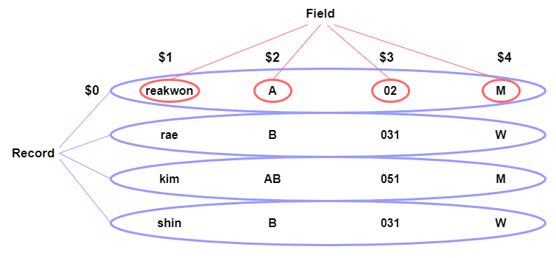
Basic Command – text manipulation
https://url.kr/y9x4i6

Slide 51
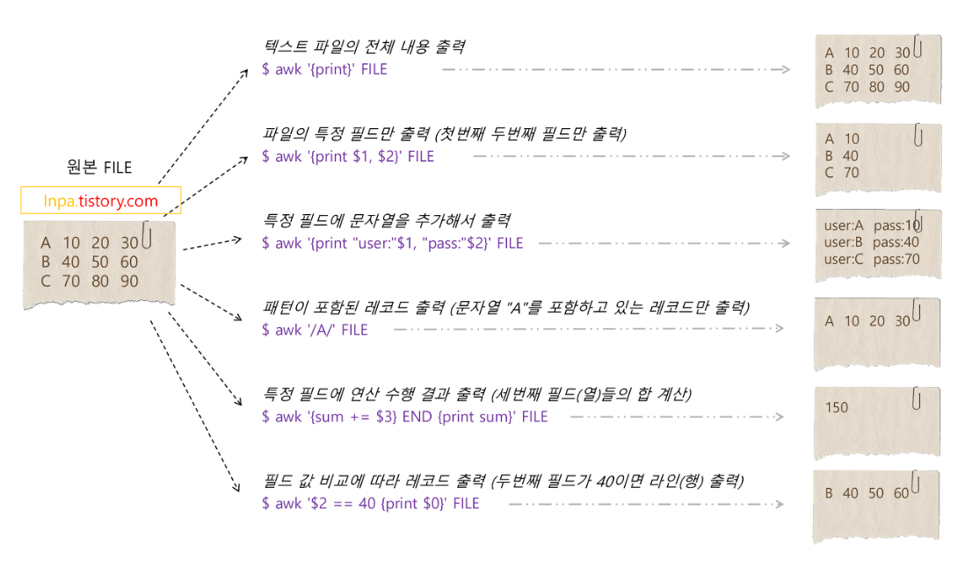
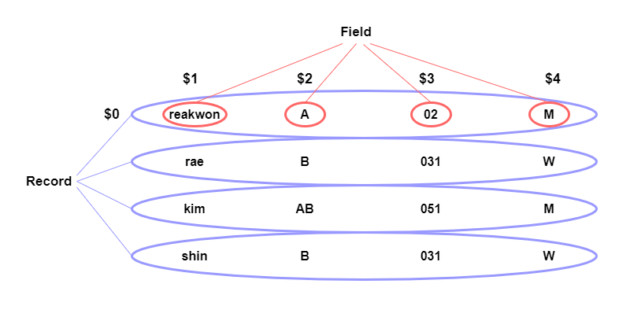
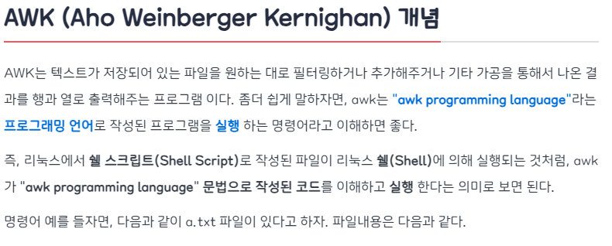
Basic Command – text manipulation
https://url.kr/y9x4i6

Slide 52
Basic Command – text manipulation
pattern { action }
pattern is typically an expression and action is a series of commands.
pattern
BEGIN : execute specified action before reading the first row.
END : execute specified action after reading the last row.
Pattern : string, condition, regular expression
action
Perform the specified action on the row that matches the pattern.
If there is no matched row, the action is performed on the entire row.
awk –F “\t” ‘/string/ { print }’ input_file
awk –F “\t” ‘$1 == “matcher” { print $0}’ input_file
awk –F “\t” ‘BEGIN {number=0} END {print number} $1 == “string” {number +=1 }’ input_file

Slide 53
Basic Command – text manipulation
awk build-in function
Function name | Description
length | The length of its argument taken as a string, or of $0 if no argument.
rand | Random number between 0 and 1
srand | Sets seed for rand and returns the previous seed.
int | Truncates to an integer value
substr(s, m, n) | The n-character substring of s that begins at position m counted from 1.
index(s, t) | The position in s where the string t occurs, or 0 if it does not.
match(s, r) | The position in s where the regular expression r occurs, or 0 if it does not. The variables RSTART and RLENGTH are set to the position and length of the matched string.
split(s, a, fs) | Splits the string s into array elements a[1], a[2], ..., a[n], and returns n. The separation is done with the regular expression fs or with the field separator FS if fs is not given. An empty string as field separator splits the string into one array element per character.
sub(r, t, s) | Substitutes t for the first occurrence of the regular expression r in the string s. If s is not given, $0 is used.
tolower(str) | Returns a copy of str with all upper-case characters translated to their corresponding lower-case equivalents.
toupper(str) | Returns a copy of str with all lower-case characters translated to their corresponding upper-case equivalents.

Slide 54
Basic Command – text manipulation
awk system variable
Variable name | Description
FS | Regular expression used to separate fields; also settable by option -Ffs.
NF | Number of fields in the current record.
NR | Ordinal number of the current record.
FILENAME | The name of the current input file.
RS | Input record separator (default: newline).
OFS | Output field separator (default: blank).
ORS | Output record separator (default: newline).
$0 | Entire input records.
$N | N-th input record.

Slide 55
Download from network
wget: be used to download files recursively from a given URL. It is part of the GNU project and follows the GNU General Public License (GPL) version 3.
wget [option] [url]
wget -O [output_file] [url] - saving the output to a file
wget -r [url] – download files recursively
curl: be used for transferring data to or from a server. It operates under the MIT license.
curl [option] [url]
curl -o [output_file] [url] - saving the output to a file

Slide 56
Data Compression
File backup is one of the most basic tasks in managing a system.
Compression process is required for file backup, which removes unnecessary or redundant data.
Lossless compression
gzip
bzip2
Lossy compression
JPEG (Image file)
MP3 (Sound file)
Linux has many compression programs such as gzip, bzip2, tar, and zip.
File Compression program
gzip : File compression and decompression programs
bzip2 : Block-based file compression program
File archiving program
tar : Used to create, maintain, modify, and extract archived files.
zip : Used to package and compress files.

Slide 57
Data Compression
gzip
Most popular compression program in Linux
Abbreviation for GNU zip.
Decompression : gunzip, gzip -d
bzip2
Compression program using a text algorithm based on burrows wheeler transform.
It is a better compression rate than gzip.
Decompression : bunzip2, bzip2 -d
Option | Description
-c | Write output to standard output
-f | Force compression or decompression even if the file has multiple links or the corresponding file already exists
-r | Travel the directory structure recursively (only gzip)
-v | Display the name and percentage reduction for each file compressed or decompressed.
-t | Check the compressed file integrity.
-number | 1 : compress faster, 9: compress slower, default : 6

Slide 58
Data Compression
zip
By default, the format created for the DOS operating system
Since then, other OSs have been supported through continuous expansion
Compress multiple files together.
Compression : zip –r [file.zip] [file]
Decompression : : unzip
tar
A command that bundles files without compression.
Unsing with gzip and bzip2.
Packing: tar cvf [file.tar] [files or directory]
Unpacking : tar xvf [file.tar]
Compression
gzip : tar cvfz [file.tar.gz] [files or directory]
bzip2 : tar cvfj [file.tar.bz2] [files or directory]
Decompression
gzip : tar xvfz [file.tar.gz]
bzip2 : tar xvfj [file.tar.bz2]

Slide 59
Ownership and Permission
drwxrwxr-x 9 User User 4096 Mar 30 13:32 test
-rw-rw-r-- 1 User User 4 Jun 11 18:43 test.txt
Owner
Group
Other
rwxrwxr-x
rw-rw-r--
File type
- nornal file
d directory
l link
p named pipe
s socket
c character device
b block device
r(read) : readable permission (4)
w(write) : writable permission (2)
x(execute) : executable permission (1)
rw-
rw-
r--
6
6
4

Slide 60
Ownership and Permission
Permission of files
r : Permission to read files
w : Permission to write files
x : Permission to execute files.
Permission of directories
r : Permission to see contents in the directory
w : Permission to create contents in the directory
x : Permission to access the directory

Slide 61
Permission Change
chmod : Be used to change the permissions of files or directories.
chmod [options] [permissions] [file name]
chmod u+x test.txt : Symbolic modes.
chmod 777 test.txt : Octal modes.
Numerical permissions
Reference
# | Permission | rwx
7 | read, write and execute | rwx
6 | read and write | rw-
5 | read and execute | r-x
4 | read only | r--
3 | write and execute | -wx
2 | write only | -w-
1 | execute only | --x
0 | none | ---
Reference | Class | Description
u | owner | file's owner
g | group | users who are members of the file's group
o | others | users who are neither the file's owner nor members of the file's group
a | all | all users
Operator
Operator | Description
+ | adds the specified modes to the specified classes
- | removes the specified modes from the specified classes
= | the modes specified are to be made the exact modes for the specified classes

Slide 62

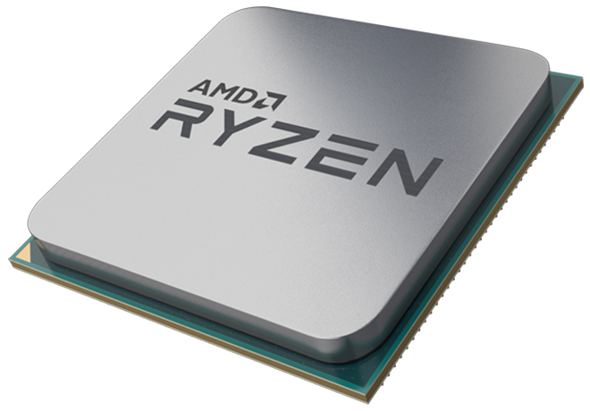
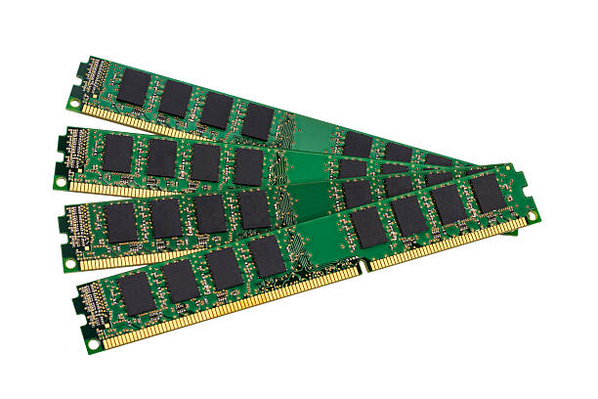
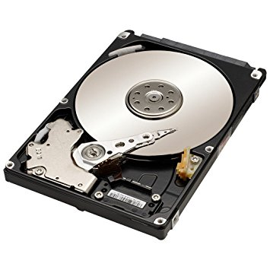
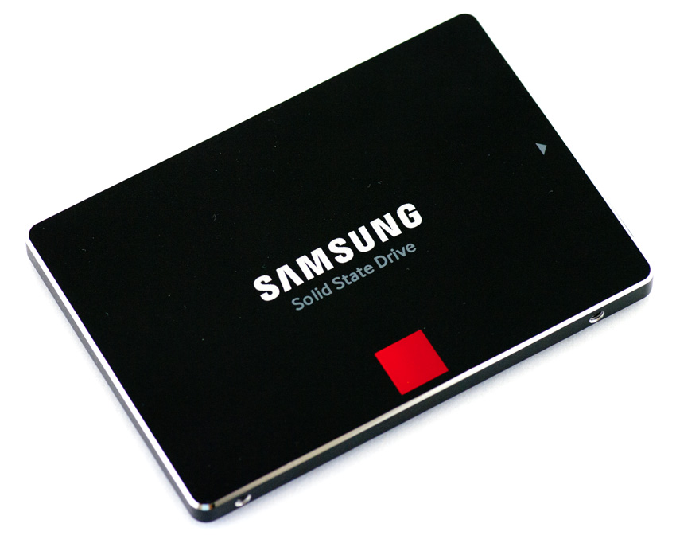
Computer processing
Processor
CPU
Memory
RAM
Storage
HDD, SSD

Slide 63
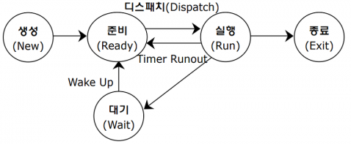
Process
Process is a computer program that is being executed.
All processes have unique PID (process ID) in Linux.
ps : Report the status of currently running processes.
top : Provide a dynamic real-time view of a running system.
kill : Terminate the process.

Slide 64

Background process
In multitasking OS, the background is where an active program is running but not visible to the user.
For example, when listening to music while browsing the Internet, your audio program runs in the background.
In Linux, a background process refers to any process initiated by the user that runs in a Linux environment.
These processes run independently of the current user session and can continue execution even if the user logs out or switches to another program.
Foreground process
Background process

Slide 65
Job Management
jobs : Print the status of all running jobs.
bg
Resume suspended jobs in background process.
bg [ job ]
Specify the job that you want to run in the background.
Job number 1 is referred to as %1, job number 2 is referred to as %2, etc.
%, %+, or %% refers to the current job
%- or - refers to the previous job.
fg
Resume suspended jobs in foreground process.
fg [ job ]
Control-Z : Pause a running process.
&(ampersand) : When a line ends with an &. command execute in background.

Slide 66
VI Editor
VI Editor is a screen-oriented text editor originally created for the Unix operating system.
This editor enables you to edit lines in context with other lines in the file.
File open command
vi filename : create a new file if it doesn’t exist, otherwise opens an existing file.
vi –R filename : open an existing file in the read-only mode.
view filename : open an existing file in the read-only mode.

Slide 67
VI Editor
Last line mode
This mode enables you to perform administrative tasks such as saving the files
In command mode, press the colon key to enter the last line mode.
Insert mode.
This mode enables you to insert text into the file. Everything that's typed in this mode is interpreted as input and placed in the file.
Press the Esc key, which will take you back to the command mode.
Command mode
This mode enables you to perform administrative tasks such as executing the commands, moving the cursor, cutting and pasting the lines or words, as well as finding and replacing.
In this mode, whatever you type is interpreted as a command.
To enter text, you must be in the insert mode for which simply type i.

Slide 68
VI Editor
Command
mode
Colon(“:”)
Last Line
mode
RETURN
Insert, Append, Open. Replace, Change
ESCAPE(“ESC”)
Insert
mode

Slide 69
Expansion
When you type a command and press the enter key in Bash, the shell performs several processes on the text before executing your command
This process is known as expansion.
With the expansion, you type something, and it is expanded into something else before the shell takes action on it.
[root@localhost]$ echo *
Desktop Documents Music Pictures Public Templates Videos

Slide 70
Expansion
Pathname Expansion
The mechanism by which wildcards work is called pathname expansion.
Tilde Expansion(~)
Tilde indicates the user’s home directory.
If you specify a name, it represents the home directory of specified name
Arithmetic Expansion
$((expression))
Shell allows arithmetic to be performed by expansion.
Brace Expansion
{a,b,c} or {a..c}
Patterns to be brace expanded contain a preamble({) and a postscript(}).
Brace expression contains either a comma-separated list of strings, or a range of integers or single characters.
The pattern may not contain whitespace.
Parameter Expansion
$variable or ${variable}
Be used to access and manipulate the values ​​of variables and parameters.

Slide 71
Command Substitution
Allow the output of a command to replace the command itself
Perform the expansion by executing and replacing the command
Occur when a command is enclosed
$(command) or `command`
[root@localhost]$ echo $(ls)
Desktop Documents Music Pictures Public Templates Videos
[root@localhost]$ ls -l $(which cp)
-rwxr-xr-x. 1 root root 155168 Nov 6 2016 /usr/bin/cp

Slide 72
Escape sequence
Escape sequence is two or more characters that often begin with an escape character(\) that tells the computer or software program to perform a function or command.
Below is a listing of some of the commonly used and available escape sequences used in programming languages and some text editors.
Option | Description
\' | Single quote
\" | Double quote
\a | Audible bell
\b | Backspace
\f | Form feed
\n | Newline
\r | Carriage return
\s | A space or white space
\t | Horizontal tab

Slide 73
What is the shell script?
Sometimes, we want to run many commands together and/or make use of control flow expressions such as conditionals and loops.
Script is a text file that is usually executed by an interpreter which is a computer program or environment that directly executes commands.
Shell script is a computer program designed to be run by the Unix shell.
Complex commands are executed in one script.
Script syntax depends on the shell type.

Slide 74
The types of shell
Bourne Shell (sh)
The Bourne Shell is the original Unix shell, created by Stephen Bourne at Bell Labs. It introduced many features found in modern shells, such as command substitution, variables, control structures (if-then-else, loops), and functions.
C Shell (csh)
The C Shell was developed by Bill Joy at the University of California, Berkeley. Its syntax is more C-like than the Bourne Shell, which can make it more intuitive for programmers
Korn Shell (ksh)
The Korn Shell was developed by David Korn at Bell Labs. It includes many features from the C Shell, as well as additional features like command-line editing and command recall.
Bourne Again Shell (bash)
The Bourne Again Shell is a free software replacement for the Bourne Shell. It was created for the GNU Project and is the default shell for most Linux distributions. It's fully compatible with sh and includes features from ksh and csh, as well as additional features like command auto-completion.
Z Shell (zsh)
The Z Shell is a shell that's similar to bash but includes many enhancements. Features include spelling correction, programmable command-line auto-completion, and a powerful scripting language.

Slide 75
Shebang
Script must begin with #!(shebang) to identify which shell to be executed.
#!/bin/bash
#!/bin/sh
Shebang is a special character that defines which interpreter should be used to run the script.
The form of a shebang interpreter directive is as follows
#! interpreter [optional-arg]
#!/bin/bash
echo “hello word”

Slide 76
Variable
Variable is the value that can change, depending on conditions or on information passed to the program.
Shell variable
Be used only in the currently logged in shell.
NAME=VALUE
Environment variable
Be used in the derived shell as well as the currently logged in shell.
export NAME=VALUE
printenv : Prints specified environment variables
Variable | Description
SHELL | This describes the shell that will be interpreting any commands you type in. In most cases, this will be bash by default, but other values can be set if you prefer other options.
SHLVL | The current shell level.
PATH | A list of directories that the system will check when looking for commands. When a user types in a command, the system will check directories in this order for the executable.
HOME | The current user's home directory.
USER | The current logged in user.

Slide 77
Variable
Variables are defined with equals sign “=“ and there is no space around the equals
key=value ex) key=”Another value”
To access the value stored in a variable, prefix its name with the dollar sign ($)
echo $key
In a Unix or Linux shell, both $key and ${key} are used to access the value of a variable. However, there are subtle differences between them:
$key : This is the simplest way to access the value of a variable named 'key’.
${key} : This is similar to $key but provides more flexibility. It's particularly useful when your variable is being used in the middle of a string or immediately adjacent to other characters where it may be unclear where the variable name ends.
#!/usr/bin/bash
name=“js"
echo $name
echo my name is $namePark.
echo my name is ${name}Park.

Slide 78
“IF” Statement (Conditional statement)
Allows us to control the flow of the script by executing different code blocks based on whether a condition is true or false.
Condition is enclosed within square brackets ([]) and can be evaluated as true or false.
Brackets must have a space before and after them.
If…else statement
if [ condition ]
then
# Code block executed when the condition is true
else
# Code block executed when the condition is false
fi
If…elif…else statement
if [ condition1 ]
then
# Code block executed when condition1 is true
elif [ condition2 ]
then
# Code block executed when condition2 is true
else
# Code block executed when all conditions are false
fi

Slide 79
“IF” Statement (Conditional statement)
The condition in the "if" statement is an expression or test that determines whether a particular condition is true or false.
option | Description
-f File | FILE exists and is a regular file.
-d File | FILE exists and is a directory.
-e File | FILE exists
STRING1 = STRING2 | the strings are equal.
STRING1 != STRING2 | the strings are not equal.
INTEGER1 -eq INTEGER2 | INTEGER1 is equal to INTEGER2
INTEGER1 -ge INTEGER2 | INTEGER1 is greater than or equal to INTEGER2
INTEGER1 -gt INTEGER2 | INTEGER1 is greater than INTEGER2
INTEGER1 -le INTEGER2 | INTEGER1 is less than or equal to INTEGER2
INTEGER1 -lt INTEGER2 | INTEGER1 is less than INTEGER2
INTEGER1 -ne INTEGER2 | INTEGER1 is not equal to INTEGER2

Slide 80
“IF” Statement (Conditional statement)
#!/bin/bash
# Check if a number is greater than 10
number=15
if [ $number -gt 10 ]
then
echo "The number is greater than 10."
else
echo "The number is not greater than 10."
fi
#!/bin/bash
# Check the grade based on a student's score
score=85
if [ $score -ge 90 ]
then
echo "Grade: A"
elif [ $score -ge 80 ]
then
echo "Grade: B"
elif [ $score -ge 70 ]
then
echo "Grade: C"
else
echo "Grade: F"
fi

Slide 81
“For” Statement (Iteration statement)
Perform a loop, iterating an action or set of actions a number of times.
“var” is the name of a variable
The words (word1 to wordN) are sequences of characters to store multiple values and are separated by spaces.
Each time the for loop executes, the value of the variable “var” is set to the next word in the list of words, word1 to wordN.
for statement
for var in word1 word2 word3 .. wordN
do
command1
command2
commandN
done
example
#!/bin/bash # Iterate over a list of fruits
fruits="apple banana cherry"
for fruit in $fruits
do
echo "I like $fruit"
done

Slide 82
Program Install
Source code
Install the desired version of the program on your system.
It is difficult to install program.
Require a lot of computer knowledge.
Binary file
Pre-compiled file by distributor.
Be used it without compile processing.
Package manager
Package is a file created by merging files required for installation. Different Linux distributions have different ways of managing packages
RedHat : RPM, Debian : dpkg
Automatic installation tool
RedHat : yum, Debian : apt-get

Slide 83
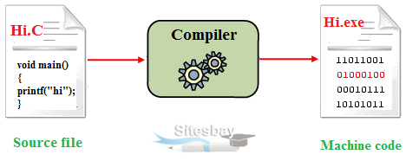
Compile
Compile is the process of creating an executable program from code.
Allow the computer to run and understand the program to interpret source code.
Compiler is computer software that transforms computer code
Configure
make
https://www.sitesbay.com/cprogramming/c-compiler
make install

Slide 84
Program Install
configure
Configuration processing for compile.
Create the “MakeFile” according to platform environment.
Set computing environment, location of system files, location of installed program.
make
Compile source code through “MakeFile”.
Must exist “MakeFile” to compile.
Create installation file.
make install
Install the installation file through make processing.

Slide 85
Startup
When you log in to the system, the shell reads the startup file (bash_profile ) and executes a series of commands.
Add the task that you want to run to ~/.bash_profile file.
ex) PATH=/home/wntjr3364/program/blast-2.2.26/bin:$PATH
source – apply the changes in the specified file to the current shell.
ex) source ~/.bash_profile

Slide 86
RPM(Redhat Package Manager)
Package management system.
Administrative tools to install and uninstall all programs used on Linux
Similar to setup.exe on Windows
The extension is “rpm”, which is called a package.
[package name]-[version]-[release number].[CentOS version].[architecture].rpm
wget-1.12-10.el6.x86.64.rpm
package name : wget
version : 1.12
release number : 10
CentOS version : Enterprise Linux 6
Architecture : x86_64

Slide 87
RPM(Redhat Package Manager)
Installation
rpm -Uvh package_name.rpm
U : package install and upgrade
v : print installation process.
h : print installation process as #.
Removal
rpm -e package_name
Check an installed Package
rpm -qa | grep “package name”
q : query
a : list of all installed packages.
Disadvantages of RPM
Dependency problem.
If “A” package has dependencies on package “B”, you need to install package “B” before installing package “A”.

Slide 88
YUM(Yellowdog Updater modified)
RPM-based packge manager.
Automatically perform system updates, including dependency analysis and obsolete processing based on "repository"
Perform installation of new packages, removal of old packages and perform queries on the installed or available packages among other commands/services
Installation : yum install [package name] or [package file name].rpm
yum install -y [pakage name] : assume that the answer to any question which would be asked is yes.
Removal : yum remove [package name]
Listing : yum list [package name]

Slide 89
The problem to install programs
Permission
In most Linux systems, you need administrative privileges to install software system-wide. This is typically accomplished by using the sudo command. If you're getting permission errors, it's likely because your user account doesn't have sudo privileges or you're not using sudo.
Package Conflicts
Sometimes, the package you're trying to install might conflict with other already installed packages. Your package manager should tell you if this is the case. Solving this issue can be complex and depends on the specific packages involved.
Source Code Compilation
If you're trying to install a program from source code, you might run into various issues, such as missing dependencies, compiler errors, or configuration problems.
Local User Installation
If you only have a local user account and can't use sudo, you might still be able to install some programs in your home directory.

Slide 90
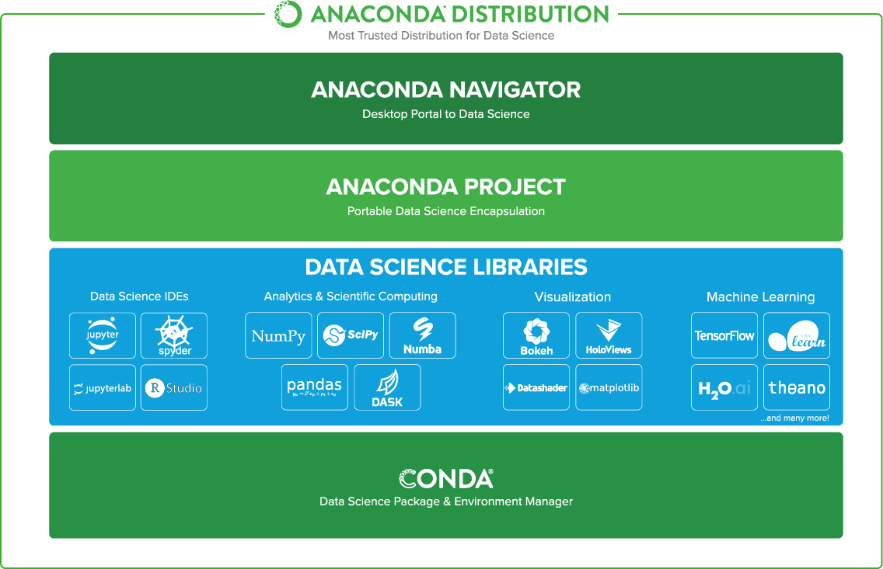
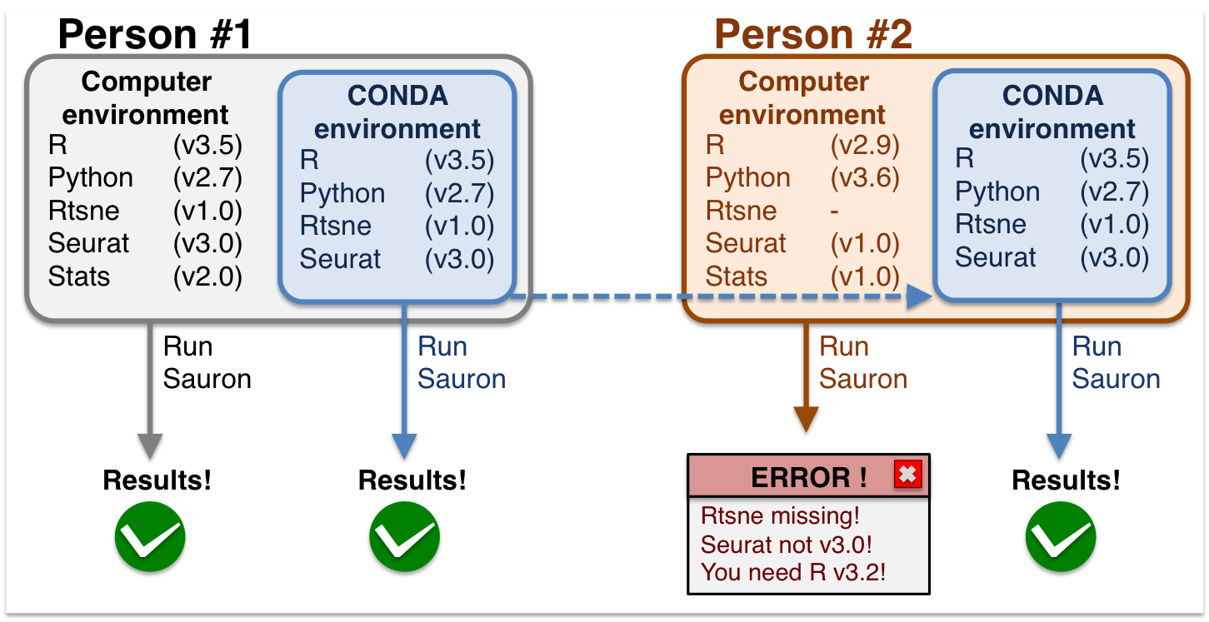
Anaconda
Anaconda is a distribution of the Python and R programming languages for scientific computing aims to simplify package management and deployment.
The distribution includes data-science packages suitable for Windows, Linux, and macOS.
Allows us to create different working environments on out computer.

Slide 91
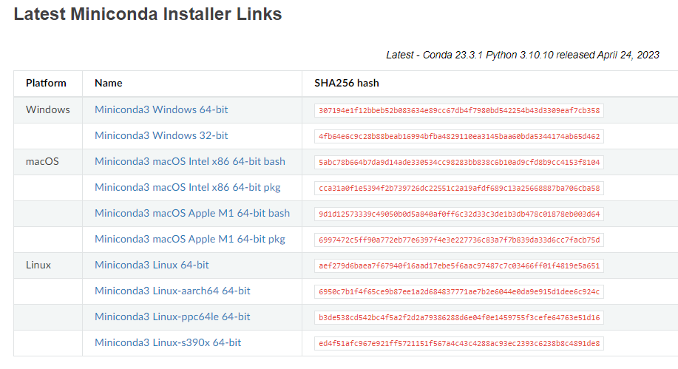
Miniconda
Miniconda
Miniconda is a free minimal installer for conda. It is a small, bootstrap version of Anaconda that includes only conda, Python, the packages they depend on, and a small number of other useful packages, including pip, zlib and a few others. Use the conda install command to install 720+ additional conda packages from the Anaconda repository.
https://docs.conda.io/en/latest/miniconda.html

Slide 92
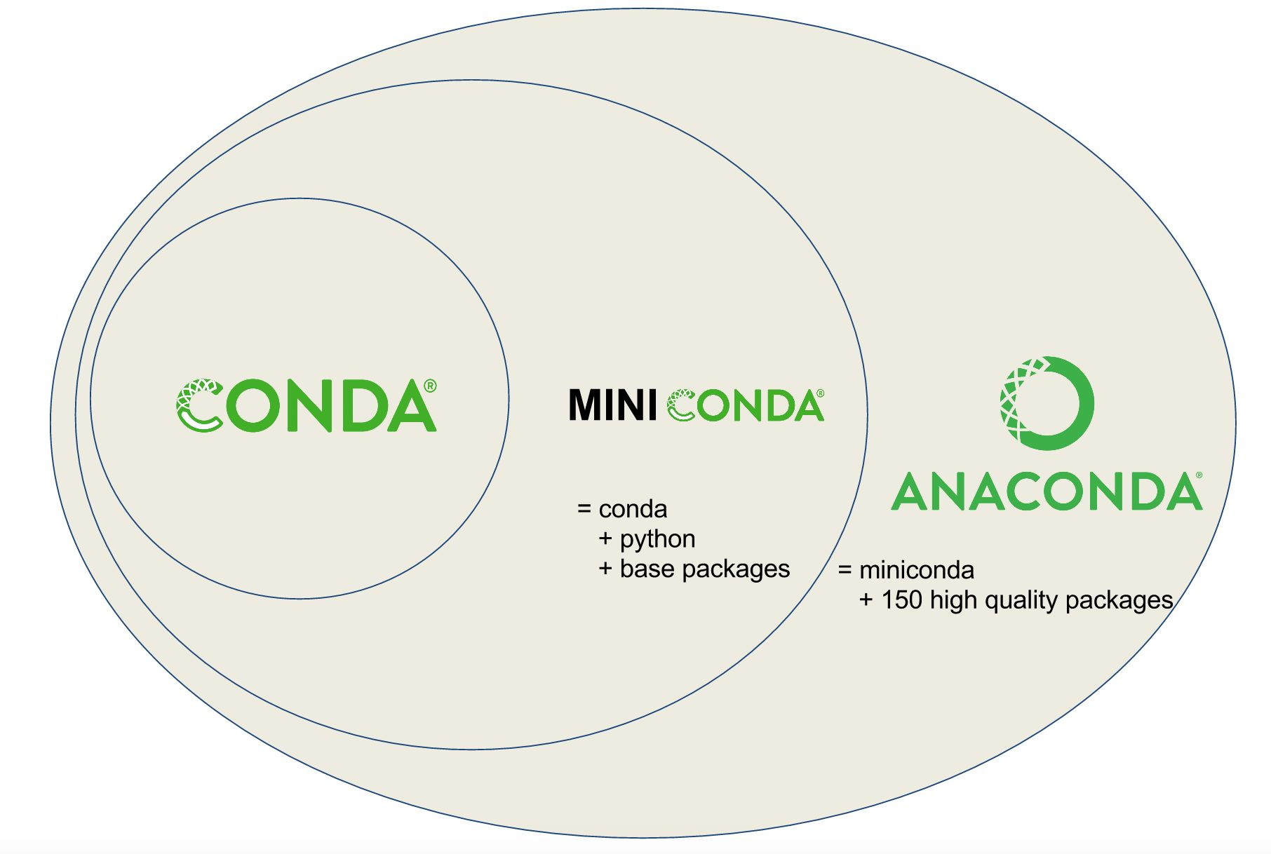
Conda
Conda is a cross-platform tool that can be used to manage your own software packages on the computer.
Conda allows us to create multiple virtual environments and switch easily, in which different versions of software tools can be installed
https://bioconda.github.io/tutorials/gcb2020.html#what-exactly-is-conda

Slide 93
Conda channel
Conda channels are the locations where packages are stored.
packages are automatically downloaded and updated from the default channel.
Channels include
Conda-forge - community channel made up of thousands of contributors.
Bioconda – for bioinformatics software
You can add a channel using the conda config --add channels command.
conda config --add channels conda-forge
Conda will prioritize packages from the channels listed first. Therefore, if the same package is available from multiple channels, Conda will install the one from the highest-priority channel.
To view your current channel list and its order, you can use:
conda config --show channels

Slide 94

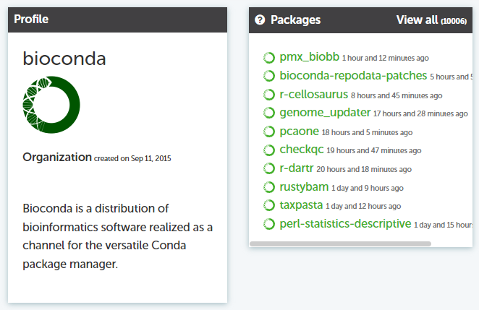
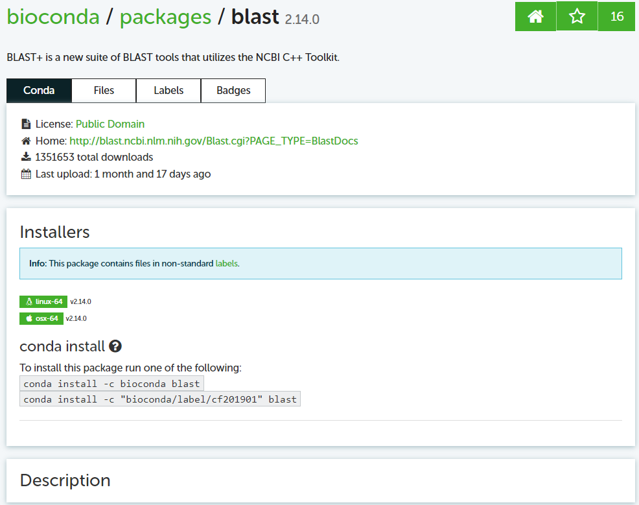
Bioconda
The bioconda is a Conda channel providing bioinformatics related packages for Linux and Mac OS. This repository hosts the corresponding recipes.
https://anaconda.org/bioconda
https://anaconda.org/bioconda/blast

Slide 95
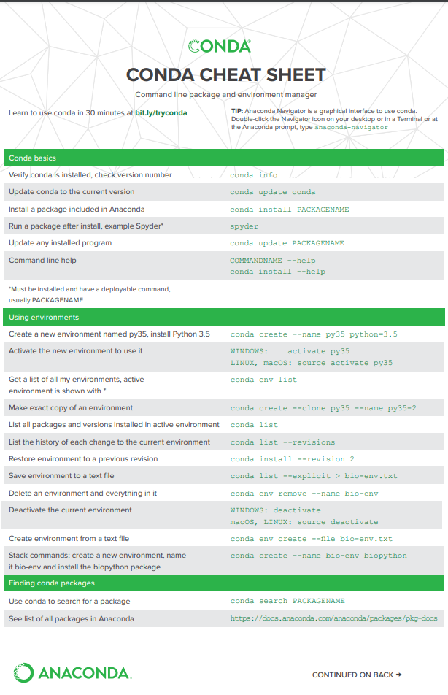
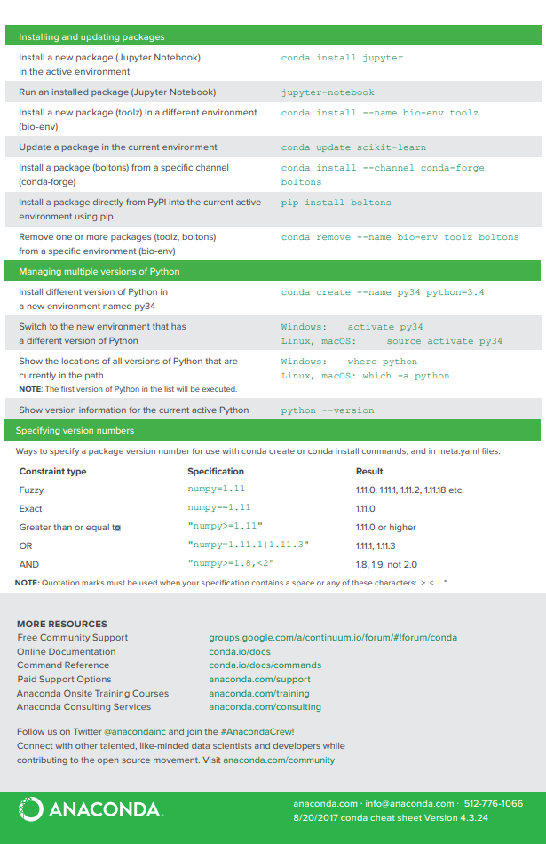
Conda cheat sheet
https://docs.conda.io/projects/conda/en/4.6.0/_downloads/52a95608c49671267e40c689e0bc00ca/conda-cheatsheet.pdf

Slide 96
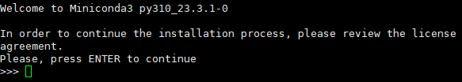
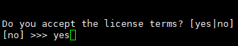
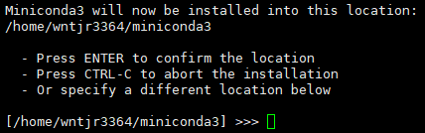
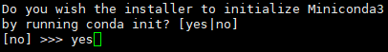
Miniconda installation
Find the download link to latest install shell script
Download the shell script
wget https://repo.anaconda.com/miniconda/Miniconda3-latest-Linux-x86_64.sh
Run the shell script
Execute “sh Miniconda3-latest-Linux-x86_64.sh”
Answer yes to all the questions
Update your installation
conda update conda
1. Press “Enter”
2. Answer “yes”
3. Press “Enter”
4. Answer “yes”

Slide 97
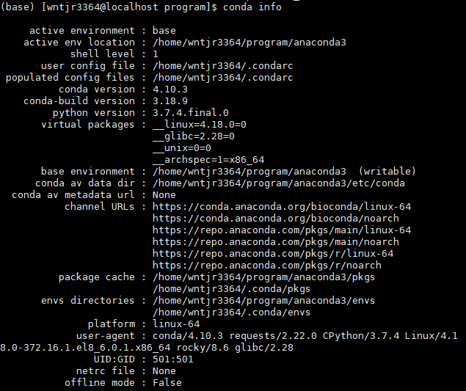
Setting up conda
The conda info command gives some basic information
To use conda to manage bioinformatics tools, add channels
Conda config --add channels bioconda
Conda config --add channels con da-forge

Slide 98
Conda environments
An environments are a way to separate space and install software independently on the same computer
By, default, conda uses the ‘base’ environment.
Conda provides a method to create virtual environments.
To create virtual environments, use the following command
conda create –name virtual_environment
Once you've created a Conda environment, you can "activate" it to use it
conda activate virtual_environment
When you're done working in an environment, you can deactivate it to return to your base environment
conda deactivate
“Conda env list command” is used to list all the conda environments that are currently available on your system.

Slide 99
Software installation
The “conda search” command is used to find software that can be installed.
The “conda install” command can be used to install software
conda install bwa blast samtools
To install a specific version of a package, append ‘=version’ after the package name.
conda install bwa = 0.7.12 install version 0.7.12
conda install bwa >= 0.7.12 install version 0.7.12 or higher
conda install bwa < 0.7.12 install version prior to 0.7.12
You can specify the channel that contains the package using the -c option
conda install -c conda-forge package-name
You can create a virtual environment and install software at the same time.
conda create --name myenv package-name

Slide 100
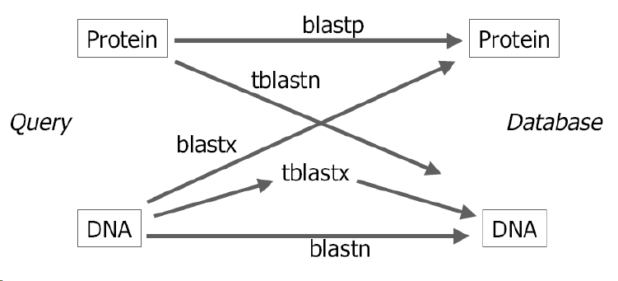
Blast

Slide 101
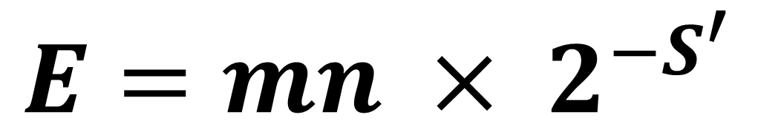
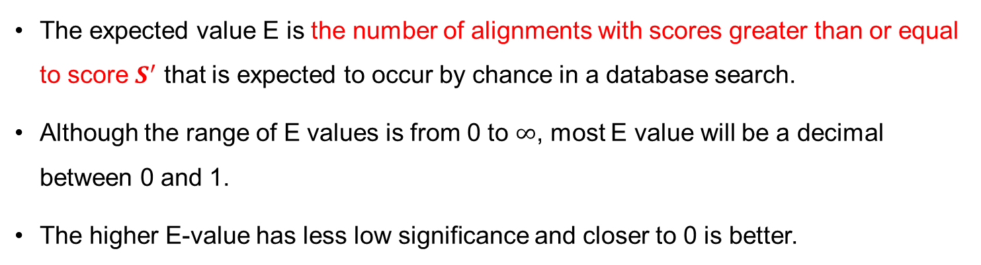
E-value
The expected value E is the number of alignments with scores greater than or equal to score $S^{′}$ that is expected to occur by chance in a database search.
Although the range of E values is from 0 to $∞$, most E value will be a decimal between 0 and 1.
The higher E-value has less low significance and closer to 0 is better.
$$E=mn × 2^{−S^{′}}$$
m : Subject length
n : Query length
S’: Bit score

Slide 102
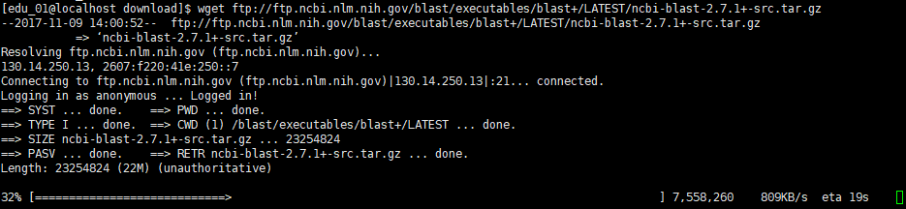
Blast installation
blast download
wget https://ftp.ncbi.nlm.nih.gov/blast/executables/blast+/LATEST/ncbi-blast-2.14.0+-src.tar.gz
configure
./configure --prefix=[install location]
make
make install

Slide 103
Make database
makeblastdb -in <db.fasta> -dbtype nucl
Option | Description
-in | Input file/database name
-dbtype | Molecule type of target db(String, nucl, prot), nucl = nucleotide, prot = protein

Slide 104
BLASTN
blastn -query <query.fa> -db <db.fa> -dust no -soft_masking false -outfmt 6 -out blast.out
Option | Description
-query | Query file name.
-db | BLAST database name.
-out | Output file name
-word_size | Length of initial exact match. (Default : 11)
-num_threads | Number of threads (CPUs) to use in blast search.
-dust | Filter query sequence with dust.
-soft_masking | Apply filtering locations as soft masks (i.e., only for finding initial matches).
-outfmt | alignment view options: 0 = Pairwise, 1 = Query-anchored showing identities, 2 = Query-anchored no identities, 3 = Flat query-anchored showing identities, 4 = Flat query-anchored no identities, 5 = BLAST XML, 6 = Tabular, 7 = Tabular with comment lines, 8 = Seqalign (Text ASN.1), 9 = Seqalign (Binary ASN.1), 10 = Comma-separated values, 11 = BLAST archive (ASN.1), 12 = Seqalign (JSON), 13 = Multiple-file BLAST JSON, 14 = Multiple-file BLAST XML2, 15 = Single-file BLAST JSON, 16 = Single-file BLAST XML2, 17 = Sequence Alignment/Map (SAM), 18 = Organism Report

Slide 105
Pairwise format
BLASTN 2.6.0+
Reference: Zheng Zhang, Scott Schwartz, Lukas Wagner, and Webb
Miller (2000), "A greedy algorithm for aligning DNA sequences", J
Comput Biol 2000; 7(1-2):203-14.
Database: Athaliana_167_TAIR9.fa
7 sequences; 119,667,750 total letters
Query= ATCG00500.1 pacid=19637947 polypeptide=ATCG00500.1 locus=ATCG00500
ID=ATCG00500.1.TAIR10 annot-version=TAIR10
Length=1467
Score E
Sequences producing significant alignments: (Bits) Value
ChrC CHROMOSOME dumped from ADB: Feb/3/09 16:10; last updated: ... 2710 0.0
Chr4 CHROMOSOME dumped from ADB: Feb/3/09 16:10; last updated: ... 145 3e-33
> ChrC CHROMOSOME dumped from ADB: Feb/3/09 16:10; last updated:
2005-06-03
Length=154478
Score = 2710 bits (1467), Expect = 0.0
Identities = 1467/1467 (100%), Gaps = 0/1467 (0%)
Strand=Plus/Plus
Query 1 ATGGAAAAATCGTGGTTCAATTTTATGTTTTCTAAGGGAGAATTGGAATACAGAGGTGAG 60
||||||||||||||||||||||||||||||||||||||||||||||||||||||||||||
Sbjct 57075 ATGGAAAAATCGTGGTTCAATTTTATGTTTTCTAAGGGAGAATTGGAATACAGAGGTGAG 57134
Query 61 CTAAGTAAAGCAATGGATAGTTTTGCTCCTGGTGAAAAGACTACTATAAGTCAAGACCGT 120
||||||||||||||||||||||||||||||||||||||||||||||||||||||||||||
Sbjct 57135 CTAAGTAAAGCAATGGATAGTTTTGCTCCTGGTGAAAAGACTACTATAAGTCAAGACCGT 57194
Query 121 TTTATATATGATATGGATAAAAACTTTTATGGTTGGGATGAGCGTTCTAGTTATTCTTCT 180
||||||||||||||||||||||||||||||||||||||||||||||||||||||||||||
Sbjct 57195 TTTATATATGATATGGATAAAAACTTTTATGGTTGGGATGAGCGTTCTAGTTATTCTTCT 57254
Query 181 AGTTATTCCAATAATGTTGATCTTTTAGTTAGCTCCAAGGACATTCGCAATTTCATATCG 240
||||||||||||||||||||||||||||||||||||||||||||||||||||||||||||
Sbjct 57255 AGTTATTCCAATAATGTTGATCTTTTAGTTAGCTCCAAGGACATTCGCAATTTCATATCG 57314
Query 241 GATGACACCTTTTTTGTTAGGGATAGTAATAAGAATAGTTATTCTATATTTTTTGATaaa 300
||||||||||||||||||||||||||||||||||||||||||||||||||||||||||||
Sbjct 57315 GATGACACCTTTTTTGTTAGGGATAGTAATAAGAATAGTTATTCTATATTTTTTGATAAA 57374
outfmt = 0 (pairwise)

Slide 106
Tabular format
outfmt = 6 (tabular)
ATCG00500.1 ChrC 100.000 1467 0 0 1 1467 57075 58541 0.0 2710
ATCG00500.1 Chr4 96.552 87 3 0 749 835 5436853 5436767 3.46e-33 145
ATCG00510.1 ChrC 100.000 114 0 0 1 114 59247 59360 2.10e-54 211
ATCG00280.1 ChrC 100.000 1422 0 0 1 1422 33720 35141 0.0 2627
ATCG00890.1 ChrC 100.000 762 0 0 409 1170 95702 94941 0.0 1408
ATCG00890.1 ChrC 100.000 762 0 0 409 1170 142947 143708 0.0 1408
ATCG00890.1 ChrC 100.000 408 0 0 1 408 96795 96388 0.0 754
ATCG00890.1 ChrC 100.000 408 0 0 1 408 141854 142261 0.0 754
ATCG00890.1 Chr2 96.250 160 6 0 68 227 9711634 9711475 7.27e-69 263
ATCG00890.1 Chr2 97.561 41 1 0 619 659 1880690 1880650 4.73e-11 71.3
ATCG00890.1 Chr3 94.737 57 1 2 280 336 20914104 20914158 4.69e-16 87.9
ATCG00890.1 Chr3 100.000 31 0 0 375 405 19372123 19372153 3.68e-07 58.4
ATCG00890.1 Chr1 100.000 45 0 0 295 339 7719480 7719524 6.07e-15 84.2
ATCG01250.1 ChrC 100.000 762 0 0 409 1170 95702 94941 0.0 1408
ATCG01250.1 ChrC 100.000 762 0 0 409 1170 142947 143708 0.0 1408
ATCG01250.1 ChrC 100.000 408 0 0 1 408 96795 96388 0.0 754
ATCG01250.1 ChrC 100.000 408 0 0 1 408 141854 142261 0.0 754
ATCG01250.1 Chr2 96.250 160 6 0 68 227 9711634 9711475 7.27e-69 263
ATCG01250.1 Chr2 97.561 41 1 0 619 659 1880690 1880650 4.73e-11 71.3
ATCG01250.1 Chr3 94.737 57 1 2 280 336 20914104 20914158 4.69e-16 87.9
ATCG01250.1 Chr3 100.000 31 0 0 375 405 19372123 19372153 3.68e-07 58.4
ATCG01250.1 Chr1 100.000 45 0 0 295 339 7719480 7719524 6.07e-15 84.2
ATCG00180.1 ChrC 100.000 1613 0 0 431 2043 21863 20251 0.0 2979
ATCG00180.1 ChrC 100.000 432 0 0 1 432 23084 22653 0.0 798
ATCG00180.1 Chr3 94.521 219 12 0 580 798 11593426 11593208 2.07e-91 339
ATCG00340.1 ChrC 100.000 2205 0 0 1 2205 39579 37375 0.0 4072
ATCG00340.1 ChrC 86.179 123 17 0 803 925 41001 40879 1.13e-29 134
ATCG00420.1 ChrC 100.000 477 0 0 1 477 49153 48677 0.0 881
ATCG00420.1 Chr4 88.166 169 17 2 96 261 7738696 7738864 8.20e-50 198
ATCG00420.1 Chr5 95.556 45 1 1 177 221 17043067 17043110 1.87e-11 71.3
ATCG00600.1 ChrC 100.000 114 0 0 1 114 65998 66111 2.10e-54 211
ATCG00210.1 ChrC 100.000 90 0 0 1 90 28089 28178 3.44e-41 167
ATCG00020.1 ChrC 100.000 1062 0 0 1 1062 1444 383 0.0 1962
ATCG00020.1 Chr2 95.591 499 12 6 554 1051 3332067 3331578 0.0 791
ATCG00020.1 ChrM 94.664 506 15 8 547 1051 334338 334832 0.0 774
ATCG01100.1 ChrC 100.000 553 0 0 1 553 122009 121457 0.0 1022
ATCG01100.1 ChrC 100.000 530 0 0 554 1083 120376 119847 0.0 979
ATCG00660.1 ChrC 100.000 354 0 0 1 354 68865 68512 0.0 654
ATCG00740.1 ChrC 100.000 990 0 0 1 990 78890 77901 0.0 1829
ATCG00740.1 Chr4 100.000 68 0 0 480 547 16921005 16921072 8.39e-28 126
ATCG00740.1 Chr4 100.000 29 0 0 165 193 5200727 5200699 4.02e-06 54.7
ATCG00820.1 ChrC 100.000 279 0 0 1 279 84283 84005 1.12e-145 516
ATCG00820.1 ChrC 100.000 113 0 0 1 113 154366 154478 2.13e-53 209
ATCG00640.1 ChrC 100.000 201 0 0 1 201 67488 67688 1.79e-102 372
ATCG01020.1 ChrC 100.000 159 0 0 1 159 113449 113607 3.04e-79 294
ATCG01060.1 ChrC 100.000 246 0 0 1 246 117563 117318 2.16e-127 455
ATCG00330.1 ChrC 100.000 303 0 0 1 303 37240 36938 5.60e-159 560
ATCG00800.1 ChrC 100.000 657 0 0 1 657 83482 82826 0.0 1214
ATCG00710.1 ChrC 100.000 222 0 0 1 222 74485 74706 4.23e-114 411
ATCG00590.1 ChrC 100.000 96 0 0 1 96 65712 65807 1.73e-44 178
ATCG01050.1 ChrC 100.000 1521 0 0 1 1521 117185 115665 0.0 2809
ATCG00050.1 ChrC 100.000 204 0 0 37 240 5287 5084 4.68e-104 377
ATCG00050.1 ChrC 100.000 41 0 0 1 41 6188 6148 1.91e-13 76.8
Num | Name | Description
1 | qseqid | query (e.g., gene) sequence id
2 | sseqid | subject (e.g., reference genome) sequence id
3 | pident | percentage of identical matches
4 | length | alignment length
5 | mismatch | number of mismatches
6 | gapopen | number of gap openings
7 | qstart | start of alignment in query
8 | qend | end of alignment in query
9 | sstart | start of alignment in subject
10 | send | end of alignment in subject
11 | evalue | expect value
12 | bitscore | bit score

Slide 107
CSV format
outfmt = 10 (csv)
ATCG00500.1,ChrC,100.000,1467,0,0,1,1467,57075,58541,0.0,2710
ATCG00500.1,Chr4,96.552,87,3,0,749,835,5436853,5436767,3.46e-33,145
ATCG00510.1,ChrC,100.000,114,0,0,1,114,59247,59360,2.10e-54,211
ATCG00280.1,ChrC,100.000,1422,0,0,1,1422,33720,35141,0.0,2627
ATCG00890.1,ChrC,100.000,762,0,0,409,1170,95702,94941,0.0,1408
ATCG00890.1,ChrC,100.000,762,0,0,409,1170,142947,143708,0.0,1408
ATCG00890.1,ChrC,100.000,408,0,0,1,408,96795,96388,0.0,754
ATCG00890.1,ChrC,100.000,408,0,0,1,408,141854,142261,0.0,754
ATCG00890.1,Chr2,96.250,160,6,0,68,227,9711634,9711475,7.27e-69,263
ATCG00890.1,Chr2,97.561,41,1,0,619,659,1880690,1880650,4.73e-11,71.3
ATCG00890.1,Chr3,94.737,57,1,2,280,336,20914104,20914158,4.69e-16,87.9
ATCG00890.1,Chr3,100.000,31,0,0,375,405,19372123,19372153,3.68e-07,58.4
ATCG00890.1,Chr1,100.000,45,0,0,295,339,7719480,7719524,6.07e-15,84.2
ATCG01250.1,ChrC,100.000,762,0,0,409,1170,95702,94941,0.0,1408
ATCG01250.1,ChrC,100.000,762,0,0,409,1170,142947,143708,0.0,1408
ATCG01250.1,ChrC,100.000,408,0,0,1,408,96795,96388,0.0,754
ATCG01250.1,ChrC,100.000,408,0,0,1,408,141854,142261,0.0,754
ATCG01250.1,Chr2,96.250,160,6,0,68,227,9711634,9711475,7.27e-69,263
ATCG01250.1,Chr2,97.561,41,1,0,619,659,1880690,1880650,4.73e-11,71.3
ATCG01250.1,Chr3,94.737,57,1,2,280,336,20914104,20914158,4.69e-16,87.9
ATCG01250.1,Chr3,100.000,31,0,0,375,405,19372123,19372153,3.68e-07,58.4
ATCG01250.1,Chr1,100.000,45,0,0,295,339,7719480,7719524,6.07e-15,84.2
ATCG00180.1,ChrC,100.000,1613,0,0,431,2043,21863,20251,0.0,2979
ATCG00180.1,ChrC,100.000,432,0,0,1,432,23084,22653,0.0,798
ATCG00180.1,Chr3,94.521,219,12,0,580,798,11593426,11593208,2.07e-91,339
ATCG00340.1,ChrC,100.000,2205,0,0,1,2205,39579,37375,0.0,4072
ATCG00340.1,ChrC,86.179,123,17,0,803,925,41001,40879,1.13e-29,134
ATCG00420.1,ChrC,100.000,477,0,0,1,477,49153,48677,0.0,881
ATCG00420.1,Chr4,88.166,169,17,2,96,261,7738696,7738864,8.20e-50,198
ATCG00420.1,Chr5,95.556,45,1,1,177,221,17043067,17043110,1.87e-11,71.3
ATCG00600.1,ChrC,100.000,114,0,0,1,114,65998,66111,2.10e-54,211
ATCG00210.1,ChrC,100.000,90,0,0,1,90,28089,28178,3.44e-41,167
ATCG00020.1,ChrC,100.000,1062,0,0,1,1062,1444,383,0.0,1962
ATCG00020.1,Chr2,95.591,499,12,6,554,1051,3332067,3331578,0.0,791
ATCG00020.1,ChrM,94.664,506,15,8,547,1051,334338,334832,0.0,774
ATCG01100.1,ChrC,100.000,553,0,0,1,553,122009,121457,0.0,1022
ATCG01100.1,ChrC,100.000,530,0,0,554,1083,120376,119847,0.0,979
ATCG00660.1,ChrC,100.000,354,0,0,1,354,68865,68512,0.0,654
ATCG00740.1,ChrC,100.000,990,0,0,1,990,78890,77901,0.0,1829
ATCG00740.1,Chr4,100.000,68,0,0,480,547,16921005,16921072,8.39e-28,126
ATCG00740.1,Chr4,100.000,29,0,0,165,193,5200727,5200699,4.02e-06,54.7
ATCG00820.1,ChrC,100.000,279,0,0,1,279,84283,84005,1.12e-145,516
ATCG00820.1,ChrC,100.000,113,0,0,1,113,154366,154478,2.13e-53,209
ATCG00640.1,ChrC,100.000,201,0,0,1,201,67488,67688,1.79e-102,372
ATCG01020.1,ChrC,100.000,159,0,0,1,159,113449,113607,3.04e-79,294
ATCG01060.1,ChrC,100.000,246,0,0,1,246,117563,117318,2.16e-127,455
ATCG00330.1,ChrC,100.000,303,0,0,1,303,37240,36938,5.60e-159,560
ATCG00800.1,ChrC,100.000,657,0,0,1,657,83482,82826,0.0,1214
ATCG00710.1,ChrC,100.000,222,0,0,1,222,74485,74706,4.23e-114,411
ATCG00590.1,ChrC,100.000,96,0,0,1,96,65712,65807,1.73e-44,178
ATCG01050.1,ChrC,100.000,1521,0,0,1,1521,117185,115665,0.0,2809
ATCG00050.1,ChrC,100.000,204,0,0,37,240,5287,5084,4.68e-104,377
ATCG00050.1,ChrC,100.000,41,0,0,1,41,6188,6148,1.91e-13,76.8
Num | Name | Description
1 | qseqid | query (e.g., gene) sequence id
2 | sseqid | subject (e.g., reference genome) sequence id
3 | pident | percentage of identical matches
4 | length | alignment length
5 | mismatch | number of mismatches
6 | gapopen | number of gap openings
7 | qstart | start of alignment in query
8 | qend | end of alignment in query
9 | sstart | start of alignment in subject
10 | send | end of alignment in subject
11 | evalue | expect value
12 | bitscore | bit score

Slide 108
Sequence Alignment Map format
outfmt = 17 (SAM)
BL_ORD_ID:6 0 Query_1 1 255 57074H1467M95937H * 0 0 * * AS:i:1467 EV:f:0 NM:i:0 PI:f:100 BS:f:2710.16
BL_ORD_ID:3 16 Query_1 749 255 13148203H87M5436766H * 0 0 * * AS:i:78 EV:f:3.46047e-33 NM:i:0 PI:f:96.55 BS:f:145.159
BL_ORD_ID:6 0 Query_2 1 255 59246H114M95118H * 0 0 * * AS:i:114 EV:f:0 NM:i:0 PI:f:100 BS:f:211.638
BL_ORD_ID:6 0 Query_3 1 255 33719H1422M119337H * 0 0 * * AS:i:1422 EV:f:0 NM:i:0 PI:f:100 BS:f:2627.06
BL_ORD_ID:6 16 Query_4 1 255 57683H408M96387H * 0 0 * * AS:i:408 EV:f:0 NM:i:0 PI:f:100 BS:f:754.553
BL_ORD_ID:6 0 Query_4 1 255 141853H408M12217H * 0 0 * * AS:i:408 EV:f:0 NM:i:0 PI:f:100 BS:f:754.553
BL_ORD_ID:1 16 Query_4 68 255 9986655H160M9711474H * 0 0 * * AS:i:142 EV:f:0 NM:i:0 PI:f:96.25 BS:f:263.345
BL_ORD_ID:2 0 Query_4 280 255 20914103H48M1D2M1D5M2545672H * 0 0 * * AS:i:47 EV:f:4.69488e-16 NM:i:2 PI:f:98.18 BS:f:87.9128
BL_ORD_ID:0 0 Query_4 295 255 7719479H45M22708147H * 0 0 * * AS:i:45 EV:f:6.07321e-15 NM:i:0 PI:f:100 BS:f:84.2195
BL_ORD_ID:2 0 Query_4 375 255 19372122H31M4087677H * 0 0 * * AS:i:31 EV:f:3.68108e-07 NM:i:0 PI:f:100 BS:f:58.3664
BL_ORD_ID:6 16 Query_4 409 255 58776H762M94940H * 0 0 * * AS:i:762 EV:f:0 NM:i:0 PI:f:100 BS:f:1408.27
BL_ORD_ID:6 0 Query_4 409 255 142946H762M10770H * 0 0 * * AS:i:762 EV:f:0 NM:i:0 PI:f:100 BS:f:1408.27
BL_ORD_ID:1 16 Query_4 619 255 17817599H41M1880649H * 0 0 * * AS:i:38 EV:f:4.72821e-11 NM:i:0 PI:f:97.56 BS:f:71.293
BL_ORD_ID:6 16 Query_5 1 255 57683H408M96387H * 0 0 * * AS:i:408 EV:f:0 NM:i:0 PI:f:100 BS:f:754.553
BL_ORD_ID:6 0 Query_5 1 255 141853H408M12217H * 0 0 * * AS:i:408 EV:f:0 NM:i:0 PI:f:100 BS:f:754.553
BL_ORD_ID:1 16 Query_5 68 255 9986655H160M9711474H * 0 0 * * AS:i:142 EV:f:0 NM:i:0 PI:f:96.25 BS:f:263.345
BL_ORD_ID:2 0 Query_5 280 255 20914103H48M1D2M1D5M2545672H * 0 0 * * AS:i:47 EV:f:4.69488e-16 NM:i:2 PI:f:98.18 BS:f:87.9128
BL_ORD_ID:0 0 Query_5 295 255 7719479H45M22708147H * 0 0 * * AS:i:45 EV:f:6.07321e-15 NM:i:0 PI:f:100 BS:f:84.2195
BL_ORD_ID:2 0 Query_5 375 255 19372122H31M4087677H * 0 0 * * AS:i:31 EV:f:3.68108e-07 NM:i:0 PI:f:100 BS:f:58.3664
BL_ORD_ID:6 16 Query_5 409 255 58776H762M94940H * 0 0 * * AS:i:762 EV:f:0 NM:i:0 PI:f:100 BS:f:1408.27
BL_ORD_ID:6 0 Query_5 409 255 142946H762M10770H * 0 0 * * AS:i:762 EV:f:0 NM:i:0 PI:f:100 BS:f:1408.27
BL_ORD_ID:1 16 Query_5 619 255 17817599H41M1880649H * 0 0 * * AS:i:38 EV:f:4.72821e-11 NM:i:0 PI:f:97.56 BS:f:71.293
BL_ORD_ID:6 16 Query_6 1 255 131394H432M22652H * 0 0 * * AS:i:432 EV:f:0 NM:i:0 PI:f:100 BS:f:798.873
BL_ORD_ID:6 16 Query_6 431 255 132615H1613M20250H * 0 0 * * AS:i:1613 EV:f:0 NM:i:0 PI:f:100 BS:f:2979.77
BL_ORD_ID:2 16 Query_6 580 255 11866404H219M11593207H * 0 0 * * AS:i:183 EV:f:0 NM:i:0 PI:f:94.52 BS:f:339.057
BL_ORD_ID:6 16 Query_7 1 255 114899H2205M37374H * 0 0 * * AS:i:2205 EV:f:0 NM:i:0 PI:f:100 BS:f:4072.98
BL_ORD_ID:6 16 Query_7 803 255 113477H123M40878H * 0 0 * * AS:i:72 EV:f:1.13296e-29 NM:i:0 PI:f:86.18 BS:f:134.079
BL_ORD_ID:6 16 Query_8 1 255 105325H477M48676H * 0 0 * * AS:i:477 EV:f:0 NM:i:0 PI:f:100 BS:f:881.972
BL_ORD_ID:3 0 Query_8 96 255 7738695H90M1I15M2I61M10846192H * 0 0 * * AS:i:107 EV:f:0 NM:i:3 PI:f:89.76 BS:f:198.712
BL_ORD_ID:4 0 Query_8 177 255 17043066H41M1D3M9932392H * 0 0 * * AS:i:38 EV:f:1.86564e-11 NM:i:1 PI:f:97.73 BS:f:71.293
BL_ORD_ID:6 0 Query_9 1 255 65997H114M88367H * 0 0 * * AS:i:114 EV:f:0 NM:i:0 PI:f:100 BS:f:211.638
BL_ORD_ID:6 0 Query_10 1 255 28088H90M126300H * 0 0 * * AS:i:90 EV:f:3.43626e-41 NM:i:0 PI:f:100 BS:f:167.319
BL_ORD_ID:6 16 Query_11 1 255 153034H1062M382H * 0 0 * * AS:i:1062 EV:f:0 NM:i:0 PI:f:100 BS:f:1962.26
BL_ORD_ID:6 16 Query_12 1 255 32469H553M121456H * 0 0 * * AS:i:553 EV:f:0 NM:i:0 PI:f:100 BS:f:1022.32
BL_ORD_ID:6 16 Query_12 554 255 34102H530M119846H * 0 0 * * AS:i:530 EV:f:0 NM:i:0 PI:f:100 BS:f:979.845
BL_ORD_ID:6 16 Query_13 1 255 85613H354M68511H * 0 0 * * AS:i:354 EV:f:0 NM:i:0 PI:f:100 BS:f:654.834
BL_ORD_ID:6 16 Query_14 1 255 75588H990M77900H * 0 0 * * AS:i:990 EV:f:0 NM:i:0 PI:f:100 BS:f:1829.3
BL_ORD_ID:3 16 Query_14 165 255 13384329H29M5200698H * 0 0 * * AS:i:29 EV:f:4.01606e-06 NM:i:0 PI:f:100 BS:f:54.6731
BL_ORD_ID:3 0 Query_14 480 255 16921004H68M1663984H * 0 0 * * AS:i:68 EV:f:8.39111e-28 NM:i:0 PI:f:100 BS:f:126.692
BL_ORD_ID:6 16 Query_15 1 255 70195H279M84004H * 0 0 * * AS:i:279 EV:f:0 NM:i:0 PI:f:100 BS:f:516.336
BL_ORD_ID:6 0 Query_15 1 255 154365H113M * 0 0 * * AS:i:113 EV:f:0 NM:i:0 PI:f:100 BS:f:209.792
BL_ORD_ID:6 0 Query_16 1 255 67487H201M86790H * 0 0 * * AS:i:201 EV:f:0 NM:i:0 PI:f:100 BS:f:372.297
BL_ORD_ID:6 0 Query_17 1 255 113448H159M40871H * 0 0 * * AS:i:159 EV:f:0 NM:i:0 PI:f:100 BS:f:294.738
BL_ORD_ID:6 16 Query_18 1 255 36915H246M117317H * 0 0 * * AS:i:246 EV:f:0 NM:i:0 PI:f:100 BS:f:455.396
BL_ORD_ID:6 16 Query_19 1 255 117238H303M36937H * 0 0 * * AS:i:303 EV:f:0 NM:i:0 PI:f:100 BS:f:560.655
BL_ORD_ID:6 16 Query_20 1 255 70996H657M82825H * 0 0 * * AS:i:657 EV:f:0 NM:i:0 PI:f:100 BS:f:1214.37
BL_ORD_ID:6 0 Query_21 1 255 74484H222M79772H * 0 0 * * AS:i:222 EV:f:0 NM:i:0 PI:f:100 BS:f:411.077

